Slide 1
Score-Based Generative Modeling through Stochastic Differential Equations
Yang Song et al.
모바일시스템공학과
박찬호
Song, Yang, et al. "Score-Based Generative Modeling through Stochastic Differential Equations." International Conference on Learning Representations.

Slide 2
Contents
Before Getting Started
Energy-based Generative Model
Score-Matching
NCSN
Score-based Generative Model
DDIM ODE
SDE

Slide 3
Before Getting Started
Yang Song, Jascha Sohl-Dickstein, Diederik P. Kingma, Abhishek Kumar, Stefano Ermon, Ben Poole
ICLR
2020
Energy-based Model → Score-matching → Langevin Dynamics → Diffusion

Slide 4
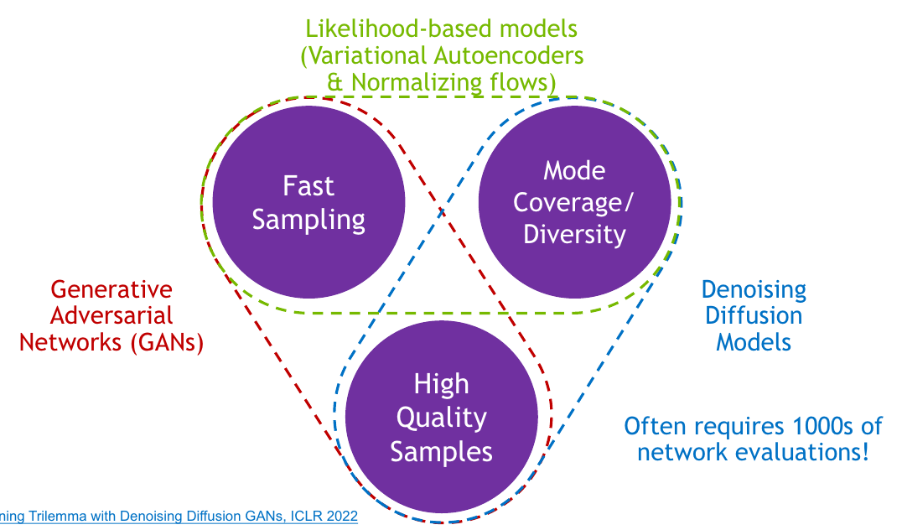
Before Getting Started
Generative models
How can we accelerate diffusion models
How can we find explicit density
How can we apply condition

Slide 5
Before Getting Started
Generative Models Timeline
2014
2015
2016
2017
2018
2019
2020
2021
2022
VAE
Original GAN
PixelRNN
EBGAN
DDPM
DDIM
StyleGAN
Stable Diffusion
DCGAN
First Diffusion*
First Flow-based**
CycleGAN
DeepFakes
PixelCNN++
SAGAN
Score-Based Generative Modeling through Stochastic Differential Equations
Diffusion Models Beat GANs on Image Synthesis
* Jascha Sohl-Dickstein et al. Unsupervised Learning using Nonequilibrium Thermodynamics ** Danilo Jimenez Rezende; Mohamed, Shakir. Variational Inference with Normalizing Flows

Slide 6
Before Getting Started
Generative Models Timeline
2014
2015
2016
2017
2018
2019
2020
2021
2022
VAE
Original GAN
PixelRNN
EBGAN
DDPM
DDIM
StyleGAN
Stable Diffusion
DCGAN
First Diffusion*
First Flow-based**
CycleGAN
DeepFakes
PixelCNN++
SAGAN
Score-Based Generative Modeling through Stochastic Differential Equations
Diffusion Models Beat GANs on Image Synthesis
* Jascha Sohl-Dickstein et al. Unsupervised Learning using Nonequilibrium Thermodynamics ** Danilo Jimenez Rezende; Mohamed, Shakir. Variational Inference with Normalizing Flows

Slide 7
Before Getting Started
Generative Models Timeline
2014
2015
2016
2017
2018
2019
2020
2021
2022
VAE
Original GAN
PixelRNN
EBGAN
DDPM
DDIM
StyleGAN
Stable Diffusion
DCGAN
First Diffusion*
First Flow-based**
CycleGAN
DeepFakes
PixelCNN++
SAGAN
Score-Based Generative Modeling through Stochastic Differential Equations
Diffusion Models Beat GANs on Image Synthesis
* Jascha Sohl-Dickstein et al. Unsupervised Learning using Nonequilibrium Thermodynamics ** Danilo Jimenez Rezende; Mohamed, Shakir. Variational Inference with Normalizing Flows

Slide 8
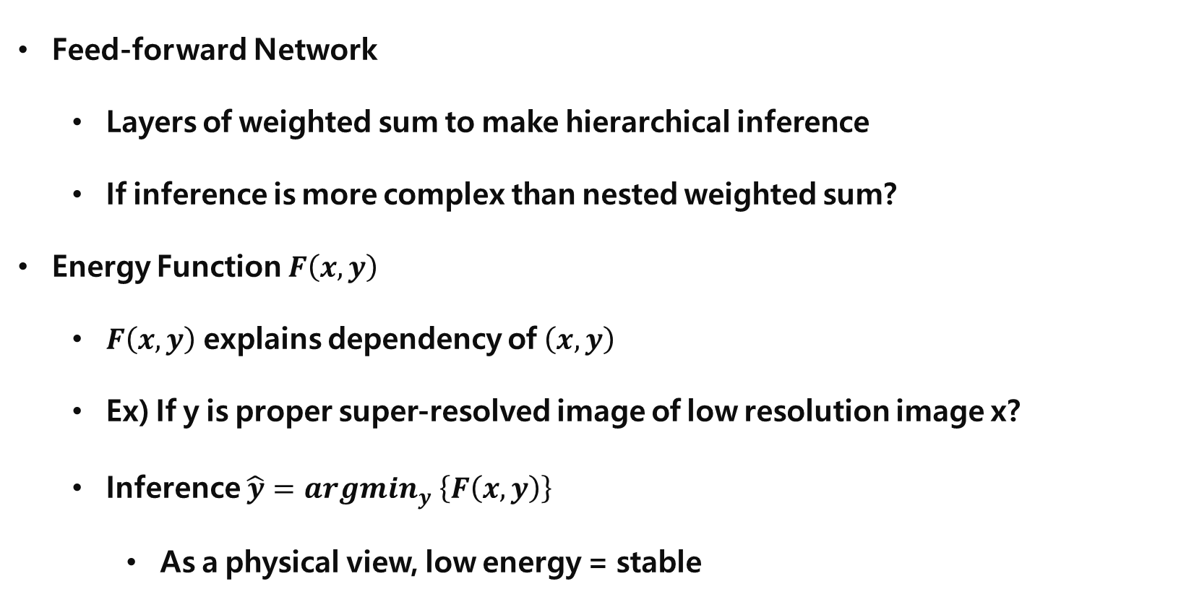
Energy-based Model
Feed-forward Network
Layers of weighted sum to make hierarchical inference
If inference is more complex than nested weighted sum?
Energy Function $F\left(x, y\right)$
$F\left(x, y\right)$ explains dependency of $\left(x, y\right)$
Ex) If y is proper super-resolved image of low resolution image x?
Inference $\hat{y}=argmin_{y} \left\{F\left(x, y\right)\right\}$
As a physical view, low energy = stable

Slide 9
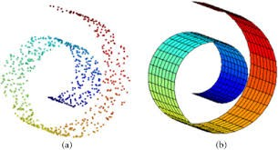
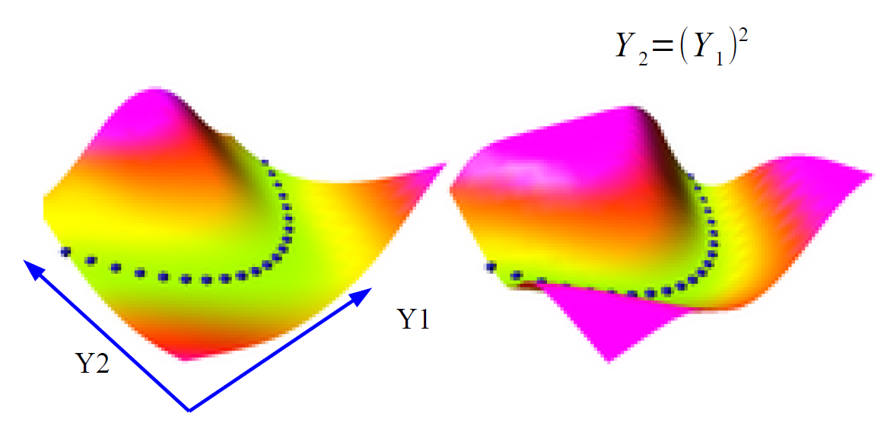
Energy-based Model
Data Manifold
Subspace describing given data
Data Manifold = Region with low energy
How do we make the energy higher outside the samples?
Strategies to shape the energy function
https://jaejunyoo.blogspot.com/2018/02/energy-based-generative-adversarial-nets-1.html

Slide 10
Energy-based Model
Data Manifold
Subspace describing given data
Data Manifold = Region with low energy
How do we make the energy higher outside the samples?
Strategies to shape the energy function
https://jaejunyoo.blogspot.com/2018/02/energy-based-generative-adversarial-nets-1.html

Slide 11
Energy-based Model
Data Manifold
Subspace describing given data
Data Manifold = Region with low energy
How do we make the energy higher outside the samples?
Strategies to shape the energy function
https://jaejunyoo.blogspot.com/2018/02/energy-based-generative-adversarial-nets-1.html

Slide 12
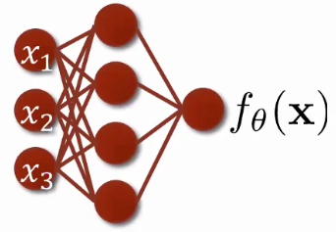
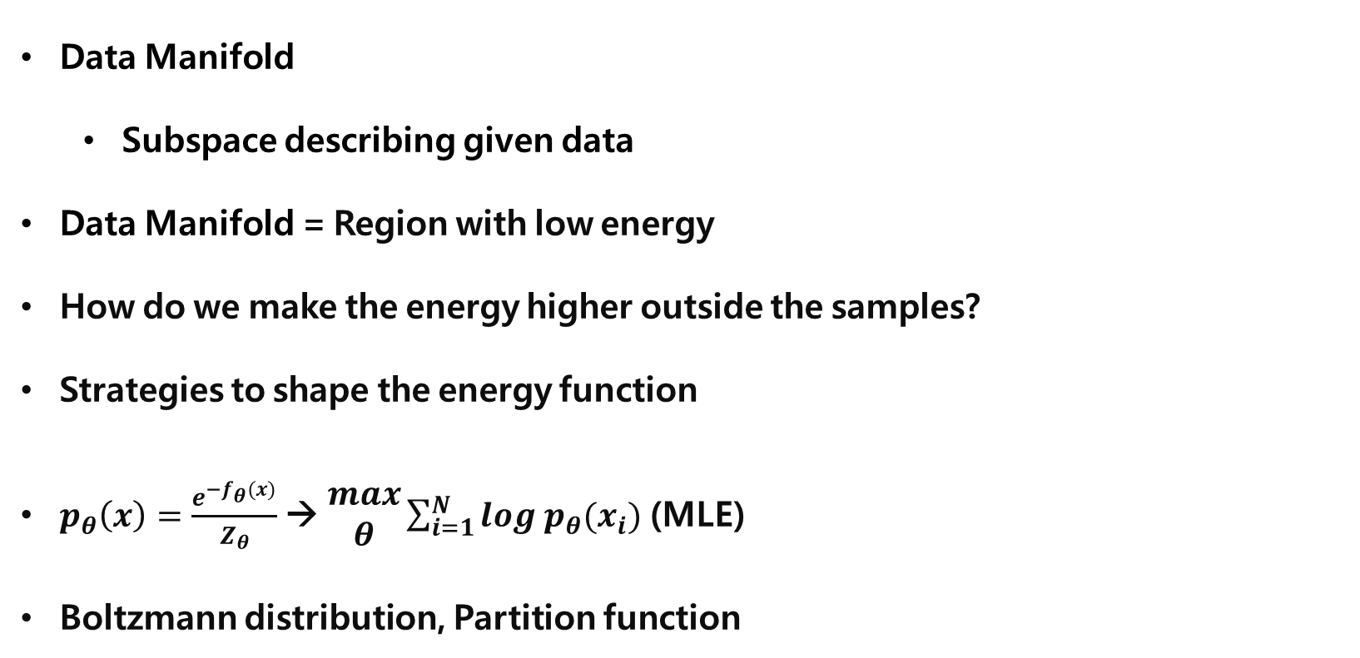
Energy-based Model
Data Manifold
Subspace describing given data
Data Manifold = Region with low energy
How do we make the energy higher outside the samples?
Strategies to shape the energy function
$p_{θ}\left(x\right)=\frac{e^{−f_{θ}(x)}}{Z_{θ}}$ → $\begin{aligned}max \\ θ\end{aligned}\sum_{i=1}^{N}{log p_{θ}(x_{i})}$ (MLE)
Boltzmann distribution, Partition function
https://slideslive.com/38957256/generative-modeling-by-estimating-gradients-of-the-data-distribution

Slide 13
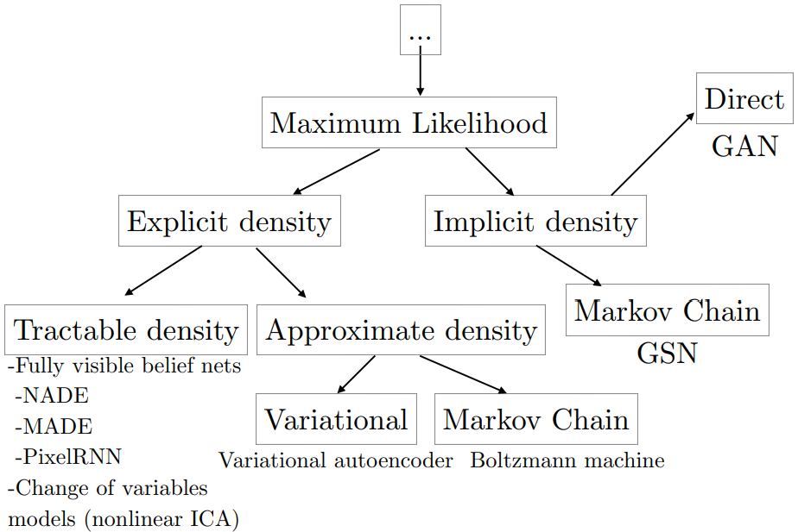
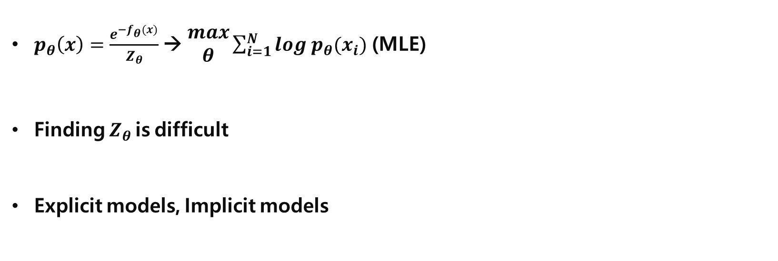
Energy-based Model
$p_{θ}\left(x\right)=\frac{e^{−f_{θ}(x)}}{Z_{θ}}$ → $\begin{aligned}max \\ θ\end{aligned}\sum_{i=1}^{N}{log p_{θ}(x_{i})}$ (MLE)
Finding $Z_{θ}$ is difficult
Explicit models, Implicit models
https://jaejunyoo.blogspot.com/2018/02/energy-based-generative-adversarial-nets-1.html

Slide 14
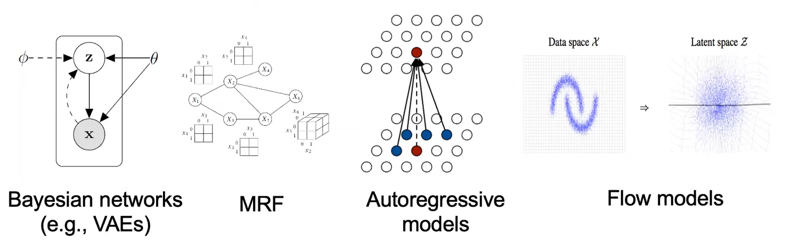
Energy-based Model
$p_{θ}\left(x\right)=\frac{e^{−f_{θ}(x)}}{Z_{θ}}$ → $\begin{aligned}max \\ θ\end{aligned}\sum_{i=1}^{N}{log p_{θ}(x_{i})}$ (MLE)
Finding $Z_{θ}$ is difficult
Explicit models, Implicit models
https://jaejunyoo.blogspot.com/2018/02/energy-based-generative-adversarial-nets-1.html

Slide 15
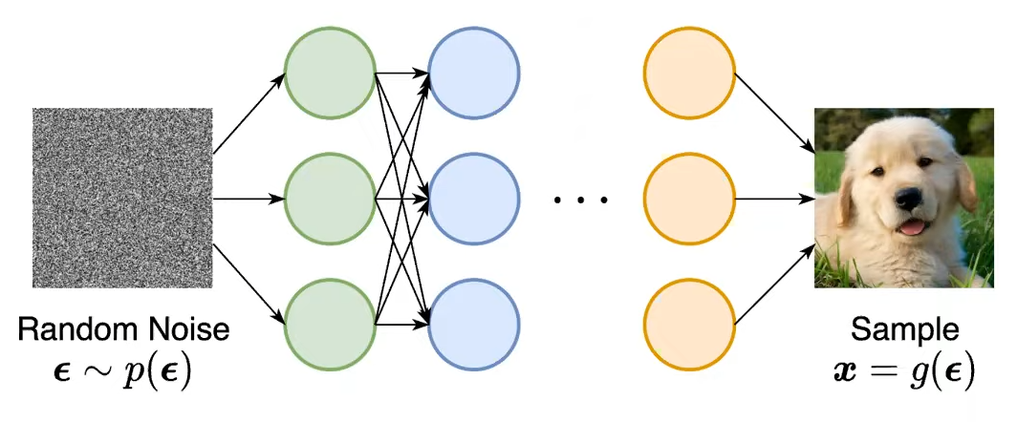
Energy-based Model
$p_{θ}\left(x\right)=\frac{e^{−f_{θ}(x)}}{Z_{θ}}$ → $\begin{aligned}max \\ θ\end{aligned}\sum_{i=1}^{N}{log p_{θ}(x_{i})}$ (MLE)
Finding $Z_{θ}$ is difficult
Explicit models, Implicit models
https://jaejunyoo.blogspot.com/2018/02/energy-based-generative-adversarial-nets-1.html

Slide 16
Energy-based Model
Strategies to make the energy higher outside the samples
Build the machine so that the volume of low energy stuff is constant
PCA, K-mean, GMM, square ICA
Push down of the energy of data points, push up everywhere else
Maximum Likelihood Estimation
Push down of the energy of data points, push up on chosen locations
EBGAN
Train a dynamical system so that the dynamics go to the manifold
Denoising auto-encoder
Regularizer
VAE
https://jaejunyoo.blogspot.com/2018/02/energy-based-generative-adversarial-nets-1.html

Slide 17
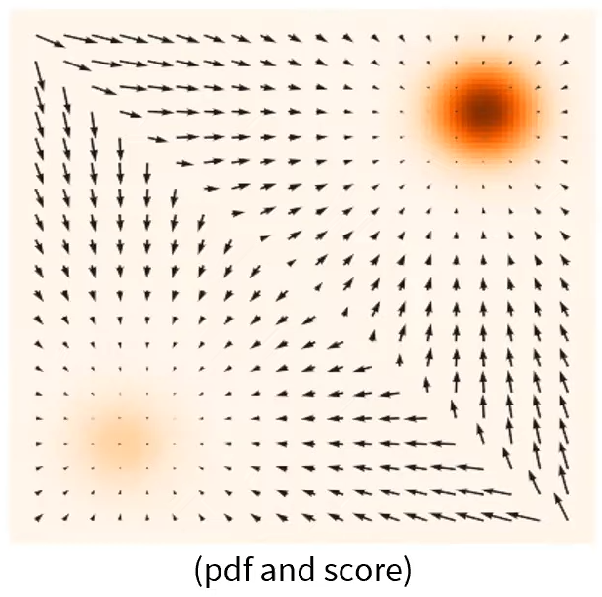
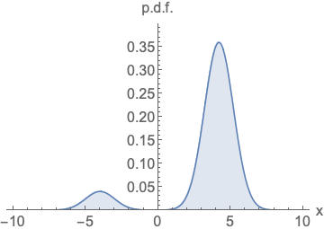
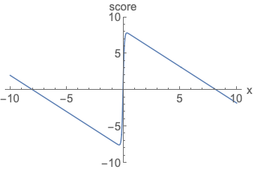
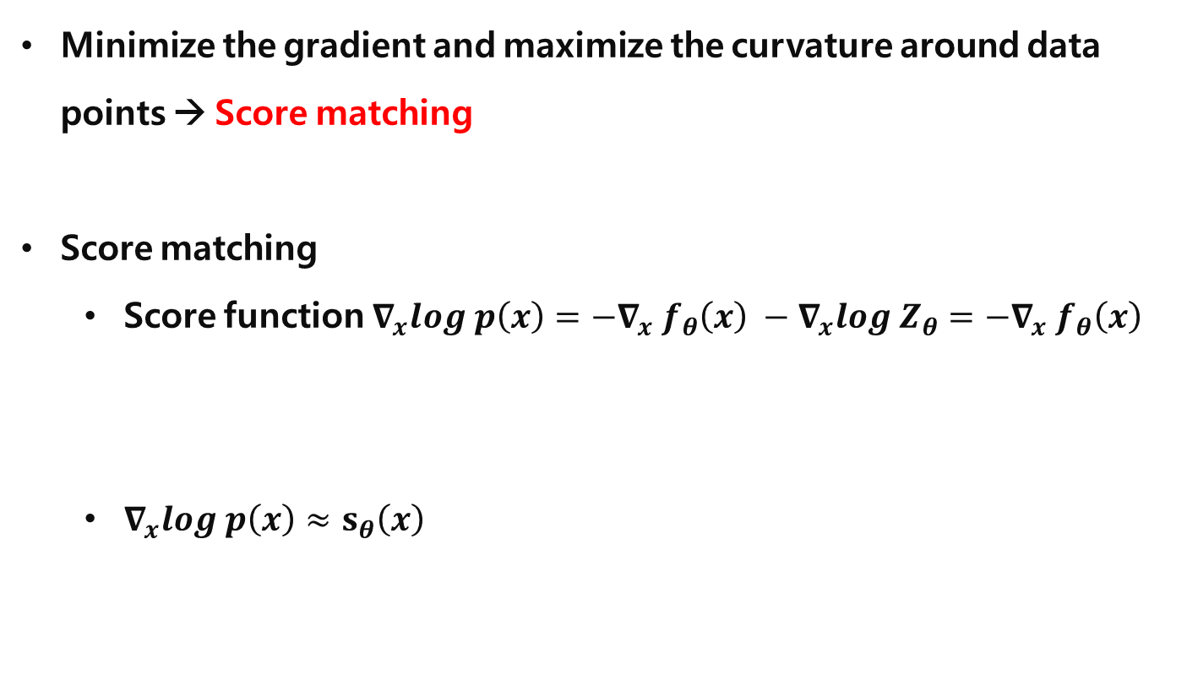
Energy-based Model
Minimize the gradient and maximize the curvature around data points → Score matching
Score matching
Score function $∇_{x}log p\left(x\right)=−∇_{x} f_{θ}\left(x\right) −∇_{x}log Z_{θ}=−∇_{x} f_{θ}\left(x\right)$
$∇_{x}log p\left(x\right)≈s_{θ}\left(x\right)$
PR-400: Score-based Generative Modeling Through Stochastic Differential Equations https://youtu.be/uG2ceFnUeQU

Slide 18
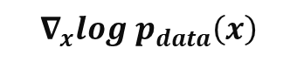
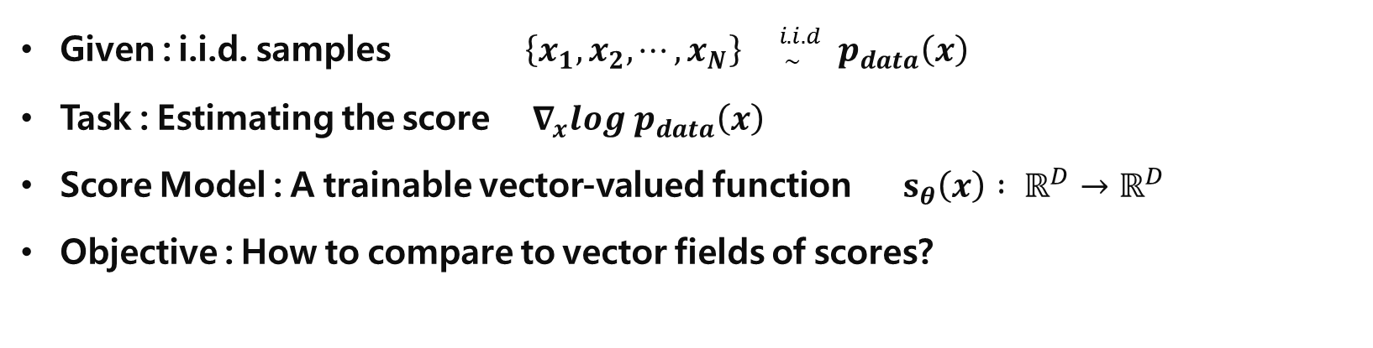
Score Matching
Given : i.i.d. samples $\left\{x_{1}, x_{2}, ⋯, x_{N}\right\} {}_{ \sim }^{i.i.d} p_{data}\left(x\right)$
Task : Estimating the score $∇_{x}log p_{data}\left(x\right)$
Score Model : A trainable vector-valued function $s_{θ}\left(x\right) : ℝ^{D}→ℝ^{D}$
Objective : How to compare to vector fields of scores?
$$∇_{x}log p_{data}\left(x\right)$$
PR-400: Score-based Generative Modeling Through Stochastic Differential Equations https://youtu.be/uG2ceFnUeQU

Slide 19

Score Matching
Given : i.i.d. samples $\left\{x_{1}, x_{2}, ⋯, x_{N}\right\} {}_{ \sim }^{i.i.d} p_{data}\left(x\right)$
Task : Estimating the score $∇_{x}log p_{data}\left(x\right)$
Score Model : A trainable vector-valued function $s_{θ}\left(x\right) : ℝ^{D}→ℝ^{D}$
Objective : How to compare to vector fields of scores?
$$∇_{x}log p_{data}\left(x\right)$$
$$s_{θ}(x)$$
PR-400: Score-based Generative Modeling Through Stochastic Differential Equations https://youtu.be/uG2ceFnUeQU

Slide 20
Score Matching
Given : i.i.d. samples $\left\{x_{1}, x_{2}, ⋯, x_{N}\right\} {}_{ \sim }^{i.i.d} p_{data}\left(x\right)$
Task : Estimating the score $∇_{x}log p_{data}\left(x\right)$
Score Model : A trainable vector-valued function $s_{θ}\left(x\right) : ℝ^{D}→ℝ^{D}$
Objective : How to compare to vector fields of scores?
PR-400: Score-based Generative Modeling Through Stochastic Differential Equations https://youtu.be/uG2ceFnUeQU

Slide 21
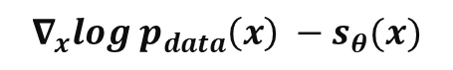
Score Matching
Given : i.i.d. samples $\left\{x_{1}, x_{2}, ⋯, x_{N}\right\} {}_{ \sim }^{i.i.d} p_{data}\left(x\right)$
Task : Estimating the score $∇_{x}log p_{data}\left(x\right)$
Score Model : A trainable vector-valued function $s_{θ}\left(x\right) : ℝ^{D}→ℝ^{D}$
Objective : How to compare to vector fields of scores?
$$∇_{x}log p_{data}\left(x\right) −s_{θ}(x)$$
PR-400: Score-based Generative Modeling Through Stochastic Differential Equations https://youtu.be/uG2ceFnUeQU

Slide 22
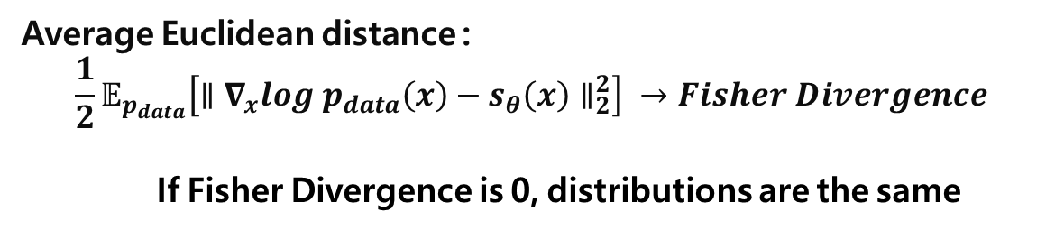
Score Matching
Given : i.i.d. samples $\left\{x_{1}, x_{2}, ⋯, x_{N}\right\} {}_{ \sim }^{i.i.d} p_{data}\left(x\right)$
Task : Estimating the score $∇_{x}log p_{data}\left(x\right)$
Score Model : A trainable vector-valued function $s_{θ}\left(x\right) : ℝ^{D}→ℝ^{D}$
Objective : How to compare to vector fields of scores?
Average Euclidean distance :
$$\frac{1}{2}𝔼_{p_{data}}\left[∥∇_{x}log p_{data}\left(x\right)−s_{θ}\left(x\right)∥_{2}^{2}\right] →Fisher Divergence$$
If Fisher Divergence is 0, distributions are the same
$$∇_{x}log p_{data}\left(x\right) −s_{θ}(x)$$
PR-400: Score-based Generative Modeling Through Stochastic Differential Equations https://youtu.be/uG2ceFnUeQU

Slide 23
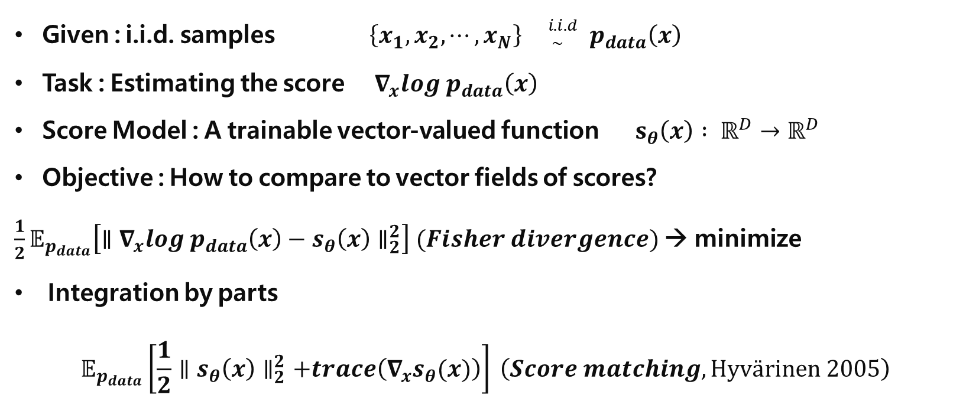
Score Matching
Given : i.i.d. samples $\left\{x_{1}, x_{2}, ⋯, x_{N}\right\} {}_{ \sim }^{i.i.d} p_{data}\left(x\right)$
Task : Estimating the score $∇_{x}log p_{data}\left(x\right)$
Score Model : A trainable vector-valued function $s_{θ}\left(x\right) : ℝ^{D}→ℝ^{D}$
Objective : How to compare to vector fields of scores?
$\frac{1}{2}𝔼_{p_{data}}\left[∥∇_{x}log p_{data}\left(x\right)−s_{θ}\left(x\right)∥_{2}^{2}\right] (Fisher divergence)$ → minimize
Integration by parts
$$𝔼_{p_{data}}\left[\frac{1}{2}∥s_{θ}\left(x\right)∥_{2}^{2}+trace\left(∇_{x}s_{θ}(x)\right)\right] \left(Score matching, Hyvärinen 2005\right)$$
PR-400: Score-based Generative Modeling Through Stochastic Differential Equations https://youtu.be/uG2ceFnUeQU

Slide 24
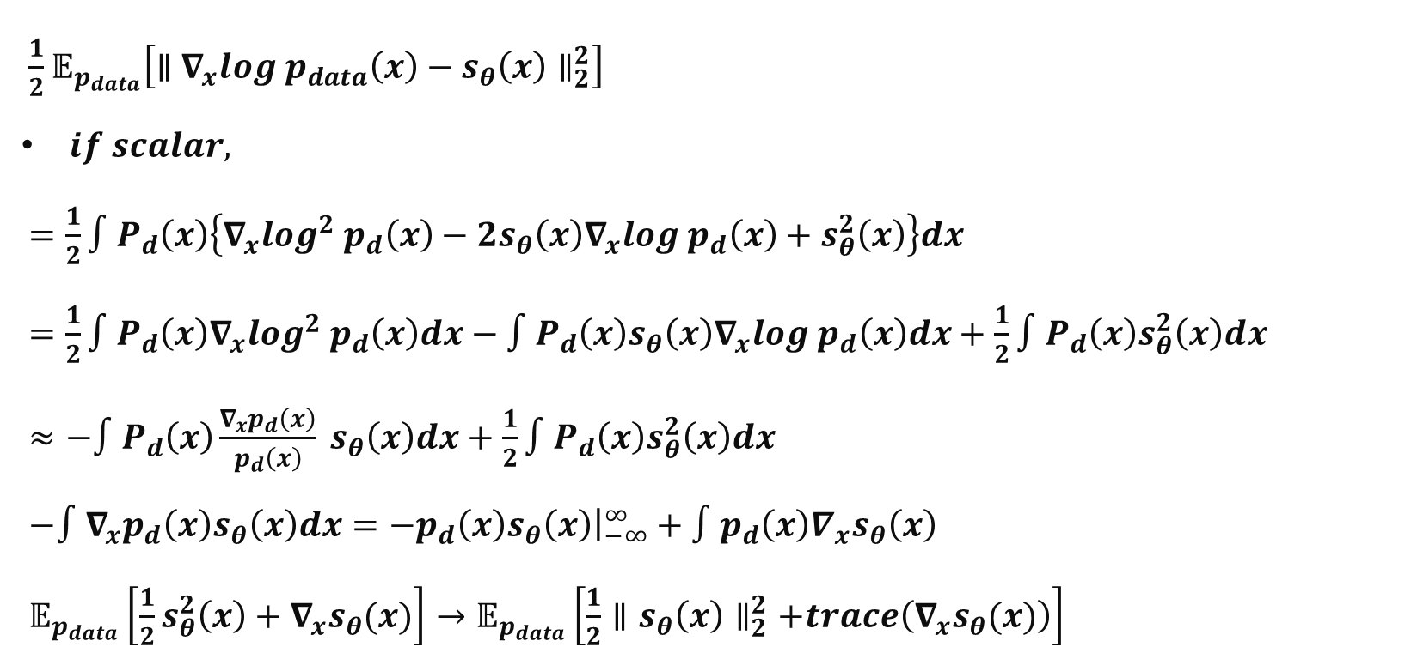
Score Matching – How?
$\frac{1}{2}𝔼_{p_{data}}\left[∥∇_{x}log p_{data}\left(x\right)−s_{θ}\left(x\right)∥_{2}^{2}\right]$
$if scalar,$
$=\frac{1}{2}∫P_{d}\left(x\right)\left\{∇_{x}log^{2} p_{d}\left(x\right)−2s_{θ}\left(x\right)∇_{x}log p_{d}\left(x\right)+s_{θ}^{2}\left(x\right)\right\}dx$
$=\frac{1}{2}∫P_{d}\left(x\right)∇_{x}log^{2} p_{d}\left(x\right)dx−∫P_{d}\left(x\right)s_{θ}\left(x\right)∇_{x}log p_{d}\left(x\right)dx+\frac{1}{2}∫P_{d}\left(x\right)s_{θ}^{2}\left(x\right)dx$
$≈−∫P_{d}\left(x\right)\frac{∇_{x}p_{d}\left(x\right)}{p_{d}\left(x\right)} s_{θ}\left(x\right)dx+\frac{1}{2}∫P_{d}\left(x\right)s_{θ}^{2}\left(x\right)dx$
$−∫∇_{x}p_{d}\left(x\right)s_{θ}\left(x\right)dx=−p_{d}\left(x\right)s_{θ}\left(x\right){\left.​\right|}_{−∞}^{∞}+∫p_{d}\left(x\right)∇_{x}s_{θ}\left(x\right)$
$𝔼_{p_{data}}\left[\frac{1}{2}s_{θ}^{2}\left(x\right)+∇_{x}s_{θ}(x)\right]→𝔼_{p_{data}}\left[\frac{1}{2}∥s_{θ}\left(x\right)∥_{2}^{2}+trace\left(∇_{x}s_{θ}(x)\right)\right]$
PR-385: Generative Modeling by Estimating Gradients of the Data Distribution https://youtu.be/m0sehjymZNU

Slide 25
Score Matching – How?
$\frac{1}{2}𝔼_{p_{data}}\left[∥∇_{x}log p_{data}\left(x\right)−s_{θ}\left(x\right)∥_{2}^{2}\right]$
$if scalar,$
$=\frac{1}{2}∫P_{d}\left(x\right)\left\{∇_{x}log^{2} p_{d}\left(x\right)−2s_{θ}\left(x\right)∇_{x}log p_{d}\left(x\right)+s_{θ}^{2}\left(x\right)\right\}dx$
$=\frac{1}{2}∫P_{d}\left(x\right)∇_{x}log^{2} p_{d}\left(x\right)dx−∫P_{d}\left(x\right)s_{θ}\left(x\right)∇_{x}log p_{d}\left(x\right)dx+\frac{1}{2}∫P_{d}\left(x\right)s_{θ}^{2}\left(x\right)dx$
$≈−∫P_{d}\left(x\right)\frac{∇_{x}p_{d}\left(x\right)}{p_{d}\left(x\right)} s_{θ}\left(x\right)dx+\frac{1}{2}∫P_{d}\left(x\right)s_{θ}^{2}\left(x\right)dx$
$−∫∇_{x}p_{d}\left(x\right)s_{θ}\left(x\right)dx=−p_{d}\left(x\right)s_{θ}\left(x\right){\left.​\right|}_{−∞}^{∞}+∫p_{d}\left(x\right)∇_{x}s_{θ}\left(x\right)$
$𝔼_{p_{data}}\left[\frac{1}{2}s_{θ}^{2}\left(x\right)+∇_{x}s_{θ}(x)\right]→𝔼_{p_{data}}\left[\frac{1}{2}∥s_{θ}\left(x\right)∥_{2}^{2}+trace\left(∇_{x}s_{θ}(x)\right)\right]$
Uncontrollable
PR-385: Generative Modeling by Estimating Gradients of the Data Distribution https://youtu.be/m0sehjymZNU

Slide 26
Score Matching – How?
$\frac{1}{2}𝔼_{p_{data}}\left[∥∇_{x}log p_{data}\left(x\right)−s_{θ}\left(x\right)∥_{2}^{2}\right]$
$if scalar,$
$=\frac{1}{2}∫P_{d}\left(x\right)\left\{∇_{x}log^{2} p_{d}\left(x\right)−2s_{θ}\left(x\right)∇_{x}log p_{d}\left(x\right)+s_{θ}^{2}\left(x\right)\right\}dx$
$=\frac{1}{2}∫P_{d}\left(x\right)∇_{x}log^{2} p_{d}\left(x\right)dx−∫P_{d}\left(x\right)s_{θ}\left(x\right)∇_{x}log p_{d}\left(x\right)dx+\frac{1}{2}∫P_{d}\left(x\right)s_{θ}^{2}\left(x\right)dx$
$≈−∫P_{d}\left(x\right)\frac{∇_{x}p_{d}\left(x\right)}{p_{d}\left(x\right)} s_{θ}\left(x\right)dx+\frac{1}{2}∫P_{d}\left(x\right)s_{θ}^{2}\left(x\right)dx$
$−∫∇_{x}p_{d}\left(x\right)s_{θ}\left(x\right)dx=−p_{d}\left(x\right)s_{θ}\left(x\right){\left.​\right|}_{−∞}^{∞}+∫p_{d}\left(x\right)∇_{x}s_{θ}\left(x\right)$
$𝔼_{p_{data}}\left[\frac{1}{2}s_{θ}^{2}\left(x\right)+∇_{x}s_{θ}(x)\right]→𝔼_{p_{data}}\left[\frac{1}{2}∥s_{θ}\left(x\right)∥_{2}^{2}+trace\left(∇_{x}s_{θ}(x)\right)\right]$
Uncontrollable
PR-385: Generative Modeling by Estimating Gradients of the Data Distribution https://youtu.be/m0sehjymZNU

Slide 27
Score Matching – How?
$\frac{1}{2}𝔼_{p_{data}}\left[∥∇_{x}log p_{data}\left(x\right)−s_{θ}\left(x\right)∥_{2}^{2}\right]$
$if scalar,$
$=\frac{1}{2}∫P_{d}\left(x\right)\left\{∇_{x}log^{2} p_{d}\left(x\right)−2s_{θ}\left(x\right)∇_{x}log p_{d}\left(x\right)+s_{θ}^{2}\left(x\right)\right\}dx$
$=\frac{1}{2}∫P_{d}\left(x\right)∇_{x}log^{2} p_{d}\left(x\right)dx−∫P_{d}\left(x\right)s_{θ}\left(x\right)∇_{x}log p_{d}\left(x\right)dx+\frac{1}{2}∫P_{d}\left(x\right)s_{θ}^{2}\left(x\right)dx$
$≈−∫P_{d}\left(x\right)\frac{∇_{x}p_{d}\left(x\right)}{p_{d}\left(x\right)} s_{θ}\left(x\right)dx+\frac{1}{2}∫P_{d}\left(x\right)s_{θ}^{2}\left(x\right)dx$
$−∫∇_{x}p_{d}\left(x\right)s_{θ}\left(x\right)dx=−p_{d}\left(x\right)s_{θ}\left(x\right){\left.​\right|}_{−∞}^{∞}+∫p_{d}\left(x\right)∇_{x}s_{θ}\left(x\right)$
$𝔼_{p_{data}}\left[\frac{1}{2}s_{θ}^{2}\left(x\right)+∇_{x}s_{θ}(x)\right]→𝔼_{p_{data}}\left[\frac{1}{2}∥s_{θ}\left(x\right)∥_{2}^{2}+trace\left(∇_{x}s_{θ}(x)\right)\right]$
Uncontrollable
0
PR-385: Generative Modeling by Estimating Gradients of the Data Distribution https://youtu.be/m0sehjymZNU

Slide 28
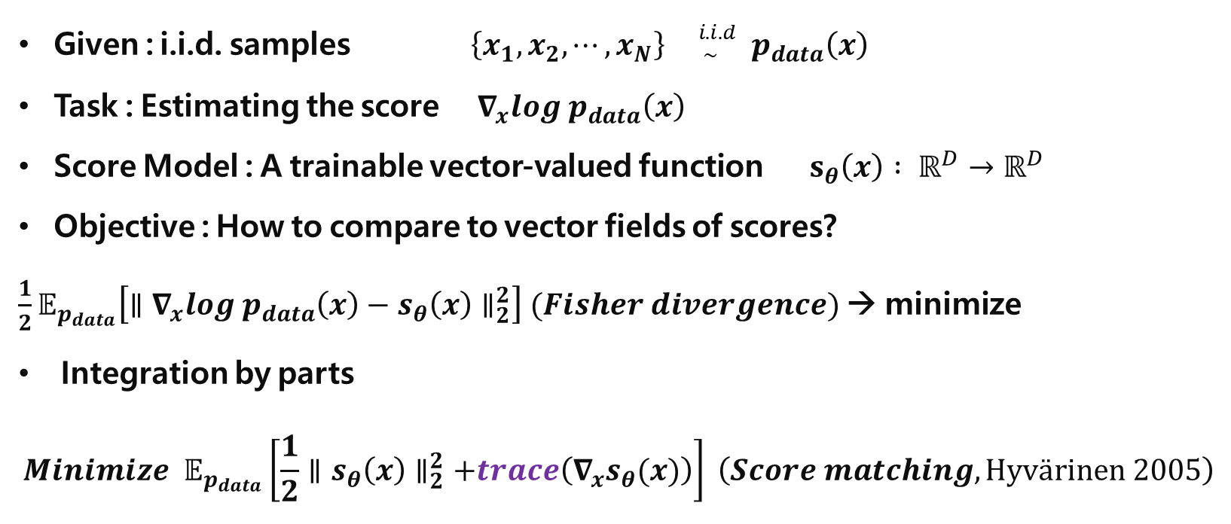
Score Matching
Given : i.i.d. samples $\left\{x_{1}, x_{2}, ⋯, x_{N}\right\} {}_{ \sim }^{i.i.d} p_{data}\left(x\right)$
Task : Estimating the score $∇_{x}log p_{data}\left(x\right)$
Score Model : A trainable vector-valued function $s_{θ}\left(x\right) : ℝ^{D}→ℝ^{D}$
Objective : How to compare to vector fields of scores?
$\frac{1}{2}𝔼_{p_{data}}\left[∥∇_{x}log p_{data}\left(x\right)−s_{θ}\left(x\right)∥_{2}^{2}\right] (Fisher divergence)$ → minimize
Integration by parts
$$Minimize 𝔼_{p_{data}}\left[\frac{1}{2}∥s_{θ}\left(x\right)∥_{2}^{2}+trace\left(∇_{x}s_{θ}(x)\right)\right] \left(Score matching, Hyvärinen 2005\right)$$
Second derivative Negative → maxima
0
→ minima or maxima
trace can be optimized by :
Sliced score matching
Denoising score matching
PR-385: Generative Modeling by Estimating Gradients of the Data Distribution https://youtu.be/m0sehjymZNU

Slide 29
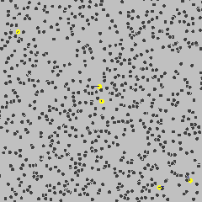
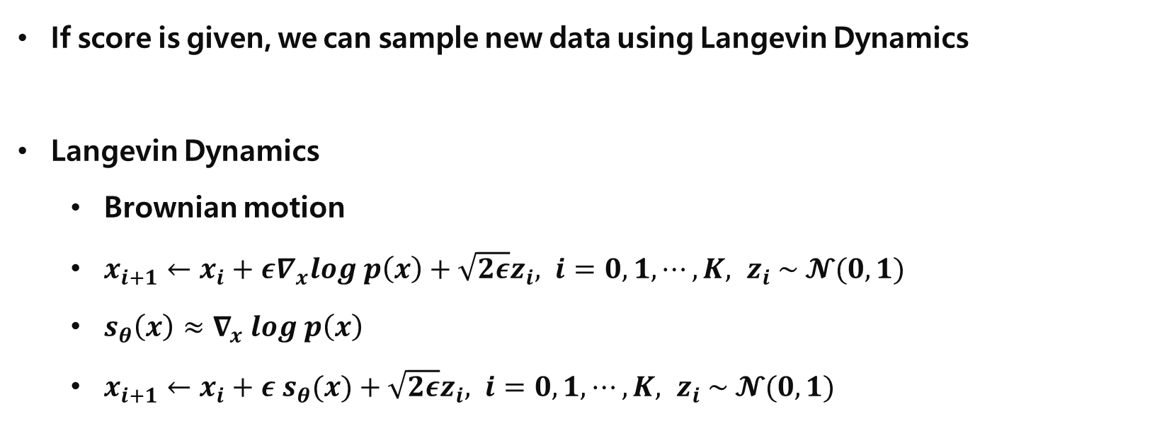
Langevin Dynamics
If score is given, we can sample new data using Langevin Dynamics
Langevin Dynamics
Brownian motion
$x_{i+1}←x_{i}+ε∇_{x}log p\left(x\right)+\sqrt{2ε}z_{i}, i=0, 1, ⋯, K, z_{i} \sim 𝓝(0, 1)$
$s_{θ}\left(x\right)≈∇_{x} log p\left(x\right)$
$x_{i+1}←x_{i}+ε s_{θ}(x)+\sqrt{2ε}z_{i}, i=0, 1, ⋯, K, z_{i} \sim 𝓝(0, 1)$
Yang Song, [blog] Generative Modeling by Estimating Gradients of the Data Distribution https://yang-song.net/blog/2021/score/

Slide 30
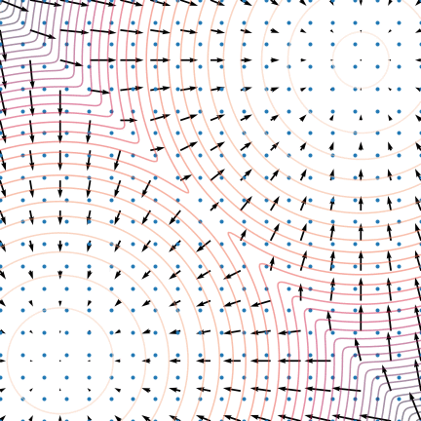
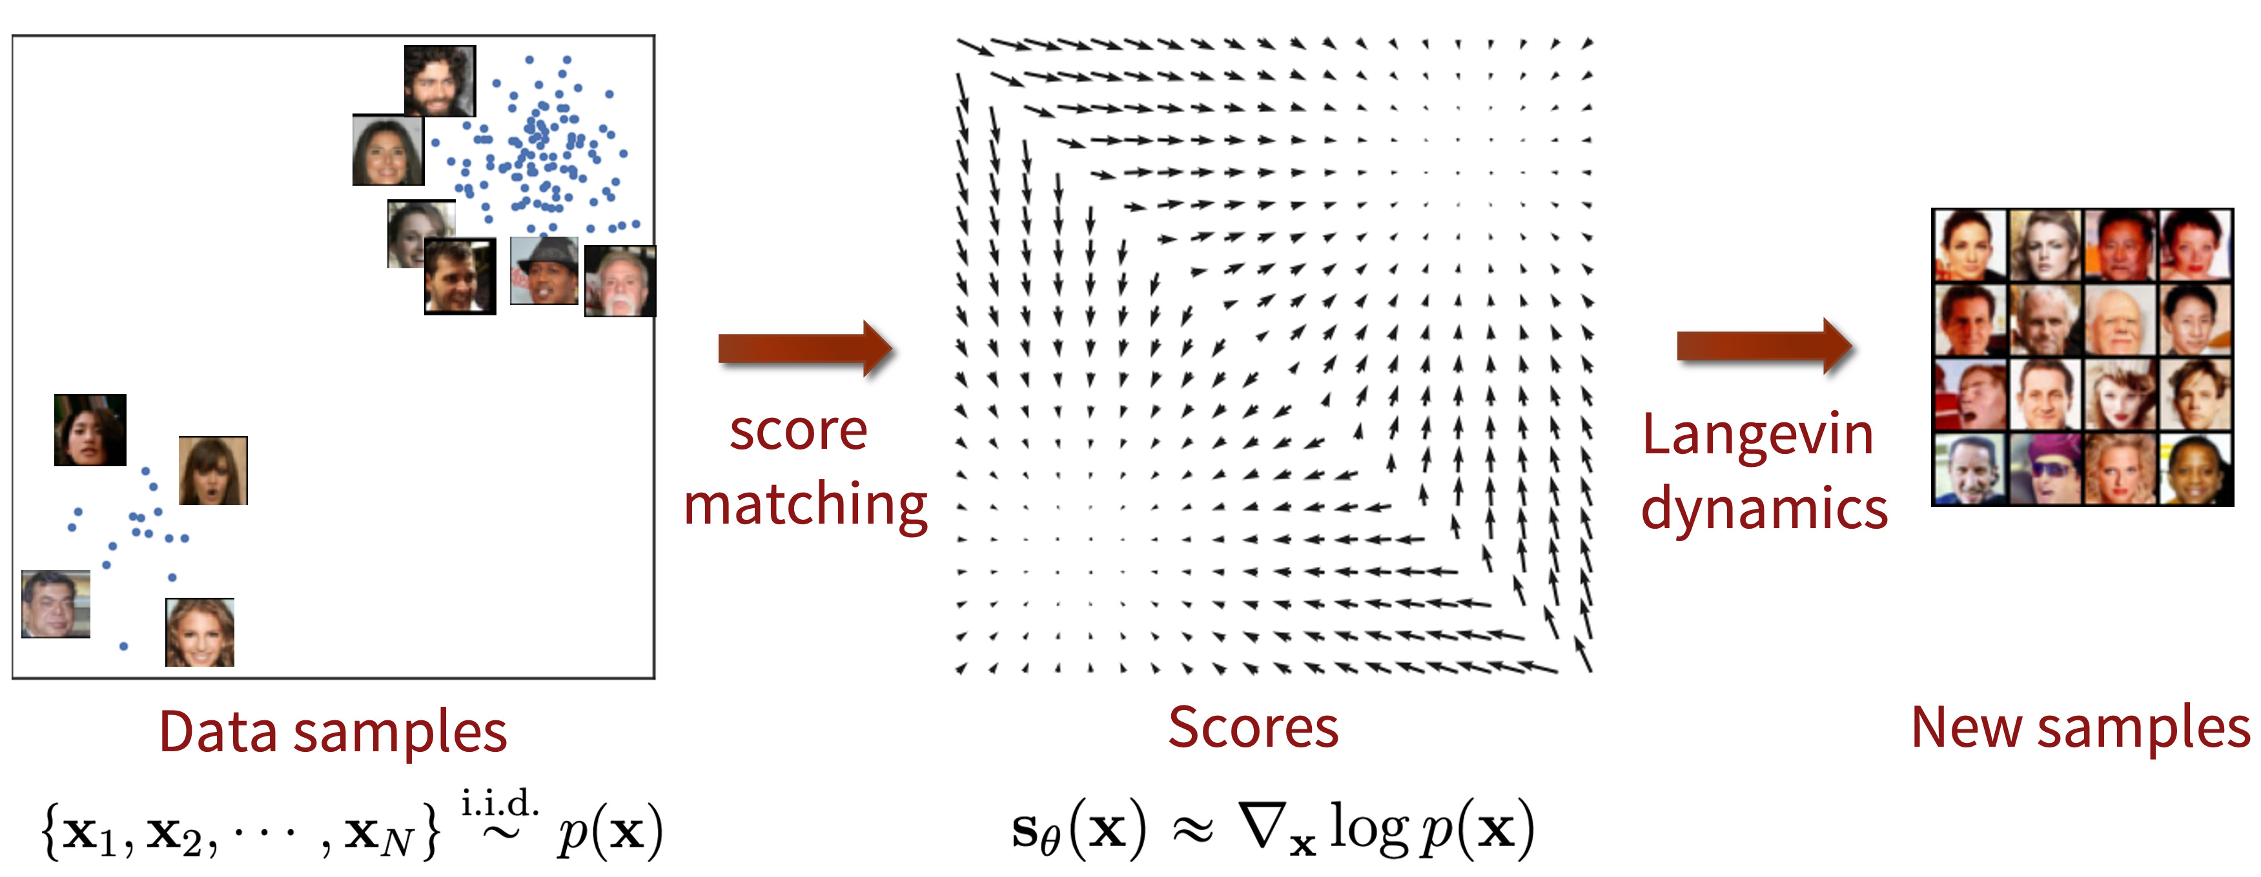
Procedure
Data distribution → Score matching → Score (vector field)
→ Langevin Dynamics (MCMC, Gradient Ascent) → Sampling
Yang Song, [blog] Generative Modeling by Estimating Gradients of the Data Distribution https://yang-song.net/blog/2021/score/

Slide 31
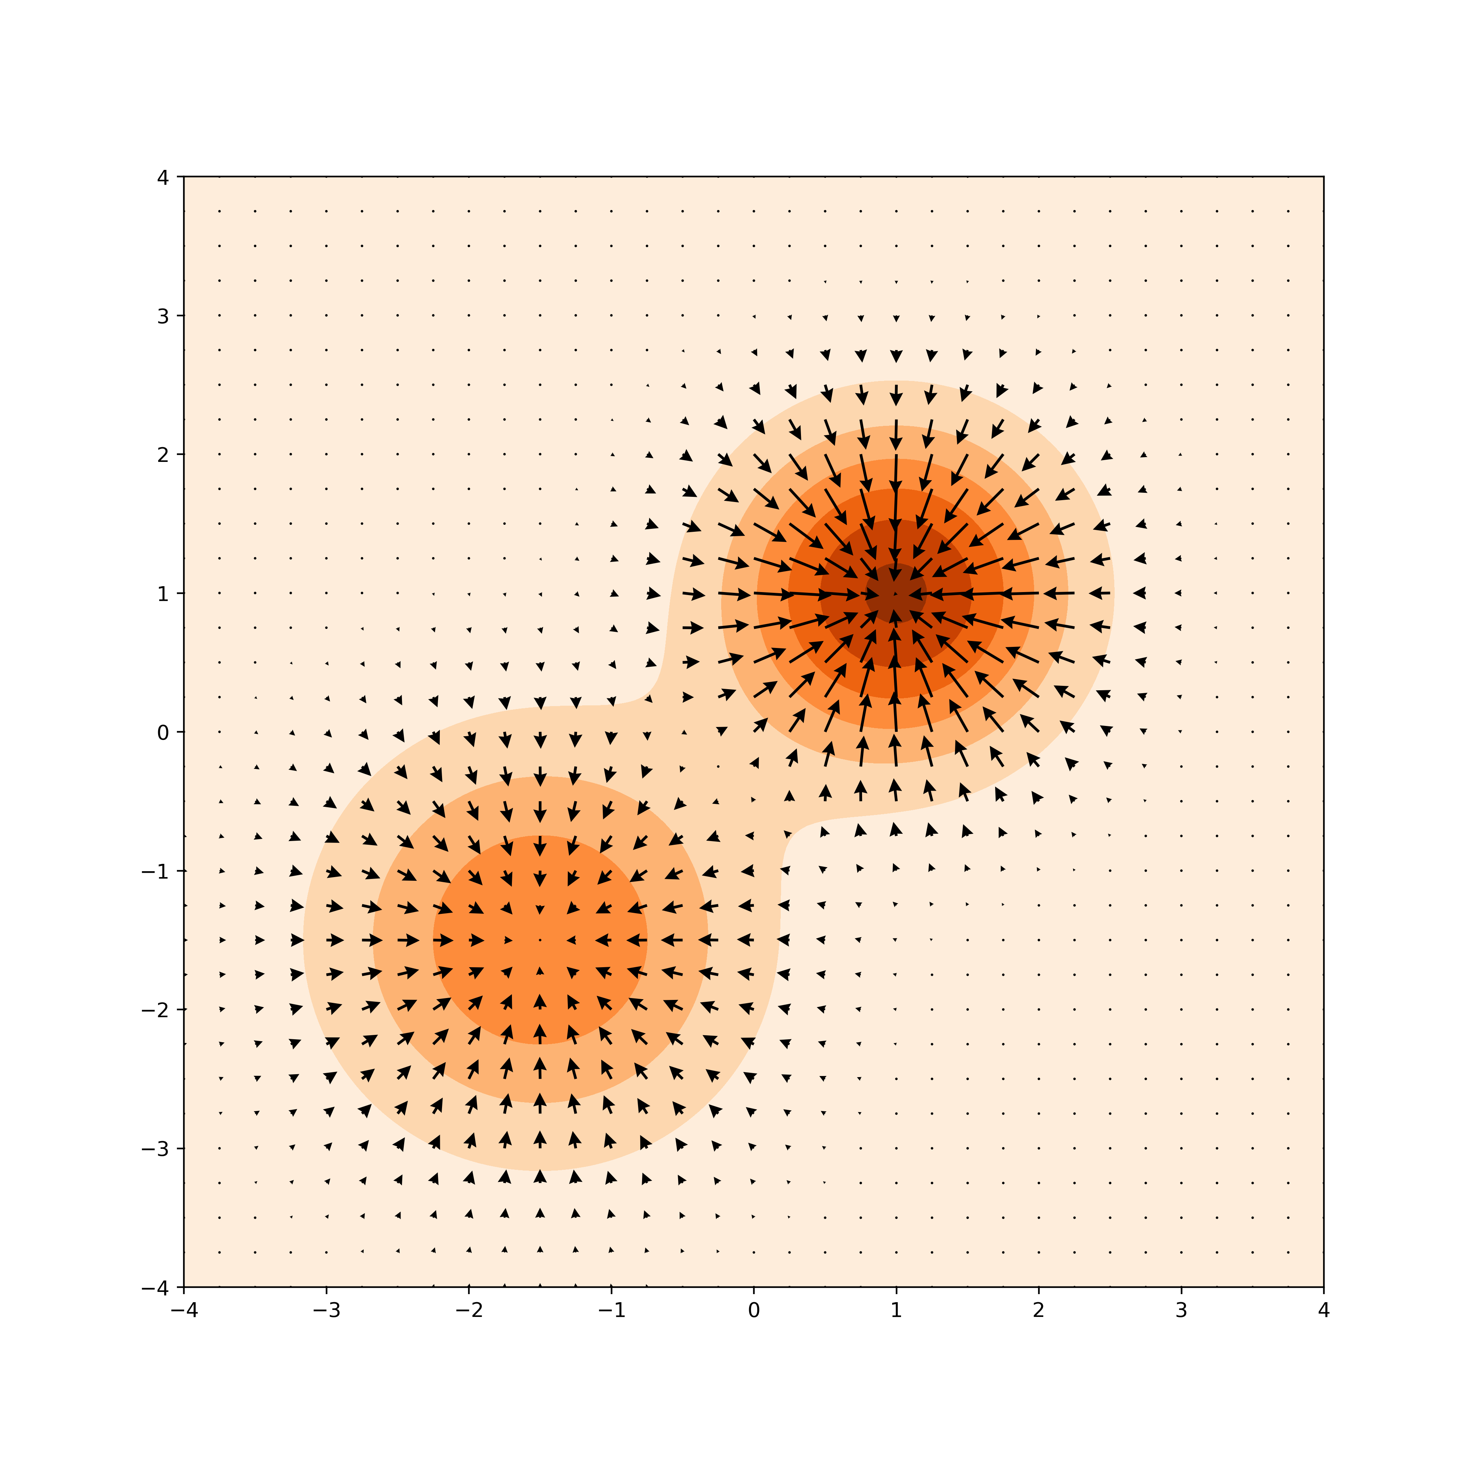
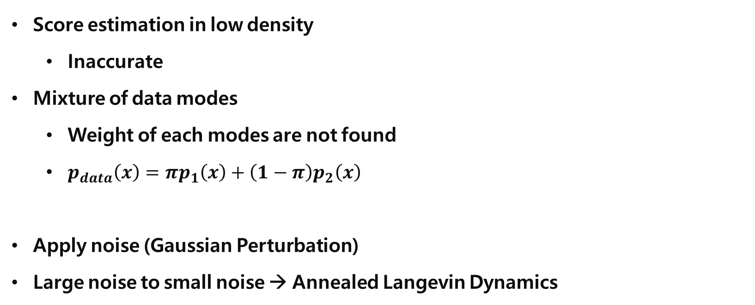
Problems
Score estimation in low density
Inaccurate
Mixture of data modes
Weight of each modes are not found
$p_{data}\left(x\right)=πp_{1}\left(x\right)+\left(1−π\right)p_{2}\left(x\right)$
Apply noise (Gaussian Perturbation)
Large noise to small noise → Annealed Langevin Dynamics
https://jihoonerd.github.io/score-based-models/

Slide 32
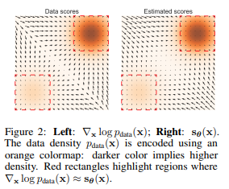
Problems
Score estimation in low density
Inaccurate
Mixture of data modes
Weight of each modes are not found
$p_{data}\left(x\right)=πp_{1}\left(x\right)+\left(1−π\right)p_{2}\left(x\right)$
Apply noise (Gaussian Perturbation)
Large noise to small noise → Annealed Langevin Dynamics
Song, Yang, and Stefano Ermon. "Generative modeling by estimating gradients of the data distribution." Advances in neural information processing systems 32 (2019).

Slide 33
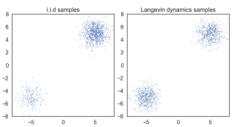
Problems
Score estimation in low density
Inaccurate
Mixture of data modes
Weight of each modes are not found
$p_{data}\left(x\right)=πp_{1}\left(x\right)+\left(1−π\right)p_{2}\left(x\right)$
Apply noise (Gaussian Perturbation)
Large noise to small noise → Annealed Langevin Dynamics
Song, Yang, and Stefano Ermon. "Generative modeling by estimating gradients of the data distribution." Advances in neural information processing systems 32 (2019).

Slide 34
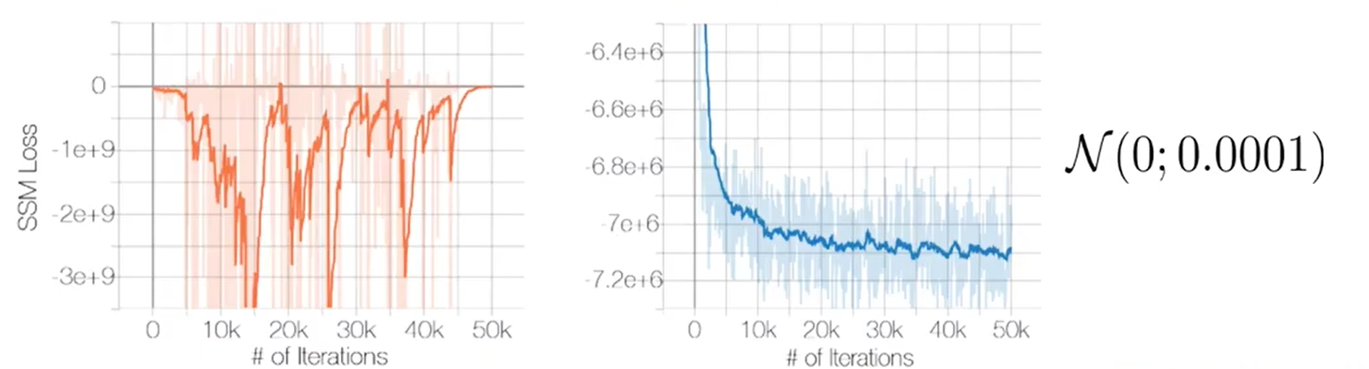
Apply Noise to Data
Score estimation in low density
Inaccurate
Mixture of data modes
Weight of each modes are not found
$p_{data}\left(x\right)=πp_{1}\left(x\right)+\left(1−π\right)p_{2}\left(x\right)$
Apply noise (Gaussian Perturbation)
Large noise to small noise → Annealed Langevin Dynamics
https://jihoonerd.github.io/score-based-models/

Slide 35
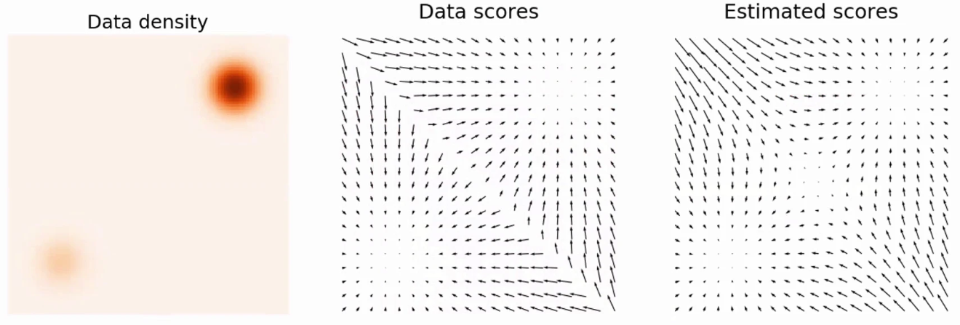
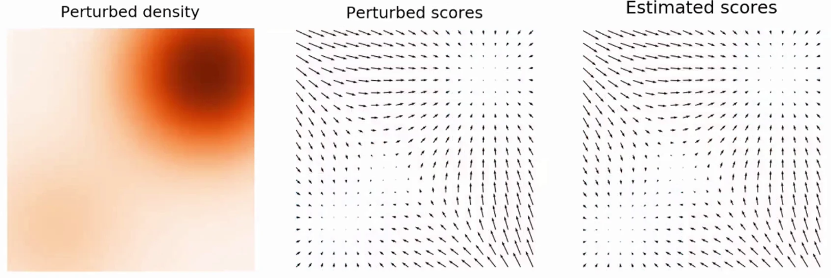
Annealed Langevin Dynamics
Not adding noise to data
Adding Noise to data
https://slideslive.com/38957256/generative-modeling-by-estimating-gradients-of-the-data-distribution

Slide 36
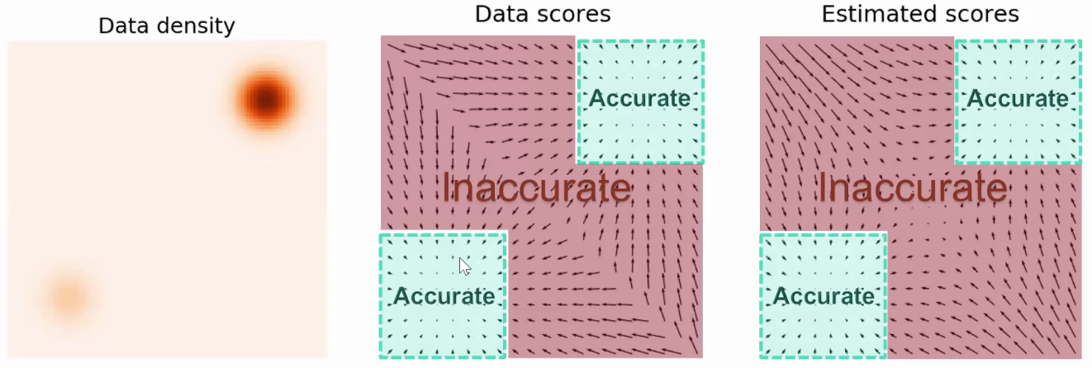
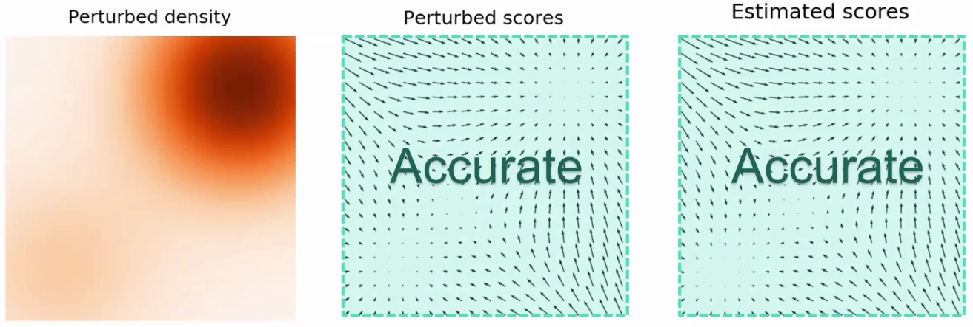
Annealed Langevin Dynamics
Not adding noise to data
Adding Noise to data
https://slideslive.com/38957256/generative-modeling-by-estimating-gradients-of-the-data-distribution

Slide 37
Annealed Langevin Dynamics
Not adding noise to data
Adding Noise to data
Slightly decreasing noise
Gaussian Perturbation
of multiple intensities
https://slideslive.com/38957256/generative-modeling-by-estimating-gradients-of-the-data-distribution

Slide 38
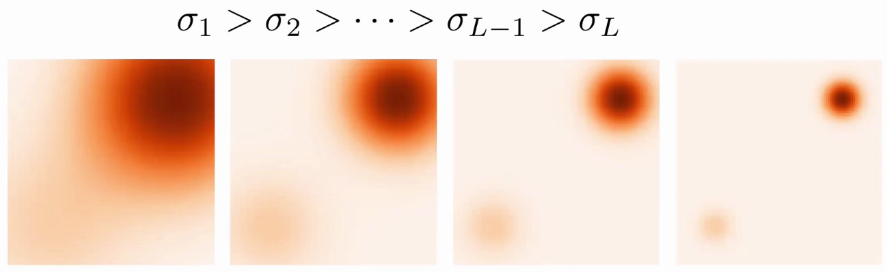
Annealed Langevin Dynamics
$σ_{i}$ decreases as the step increases
https://slideslive.com/38957256/generative-modeling-by-estimating-gradients-of-the-data-distribution

Slide 39
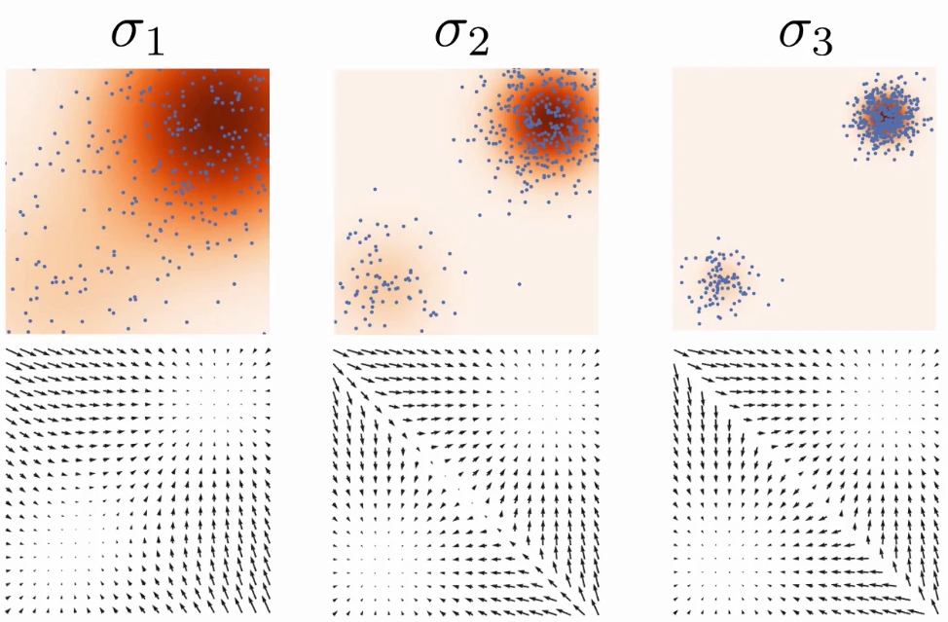
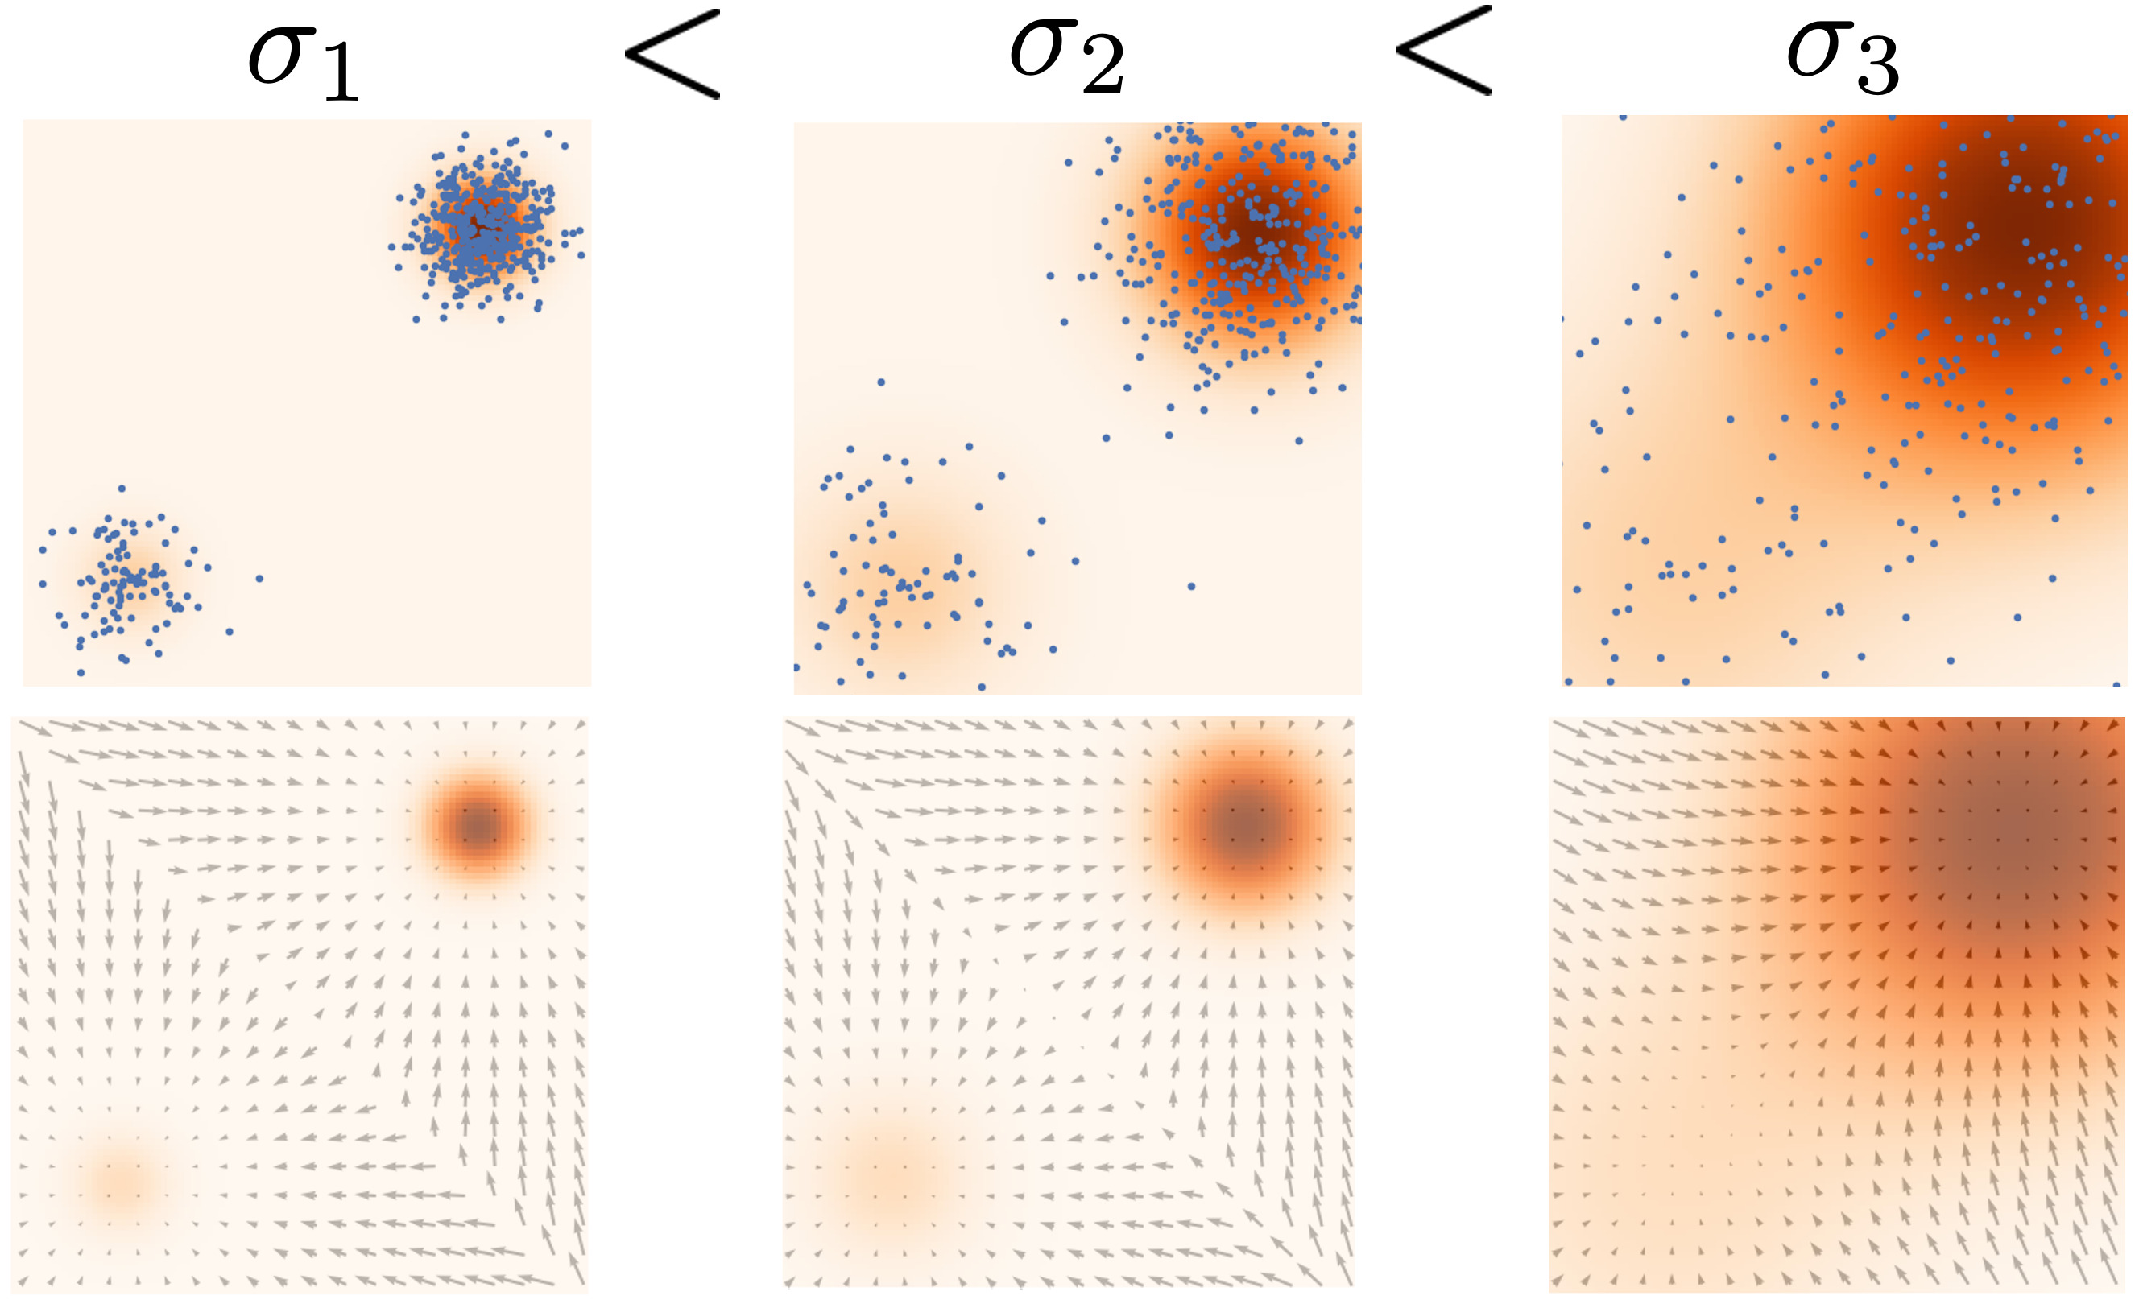
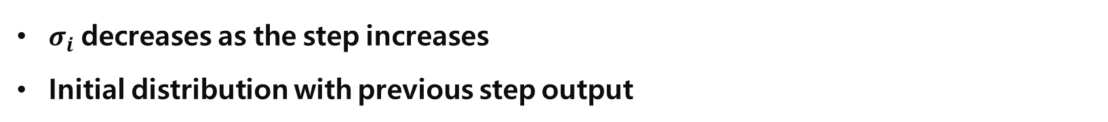
Annealed Langevin Dynamics
$σ_{i}$ decreases as the step increases
Initial distribution with previous step output
https://slideslive.com/38957256/generative-modeling-by-estimating-gradients-of-the-data-distribution

Slide 40
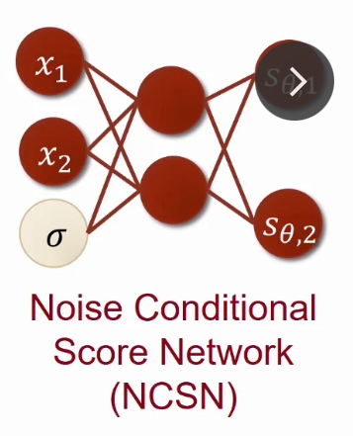
NCSN
$σ_{i}$ decreases as the step increases
Initial distribution with previous step output
https://slideslive.com/38957256/generative-modeling-by-estimating-gradients-of-the-data-distribution

Slide 41
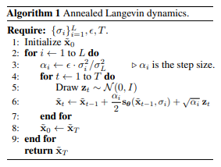
NCSN
$σ_{i}$ decreases as the step increases
Initial distribution with previous step output
Song, Yang, and Stefano Ermon. "Generative modeling by estimating gradients of the data distribution." Advances in neural information processing systems 32 (2019).

Slide 42
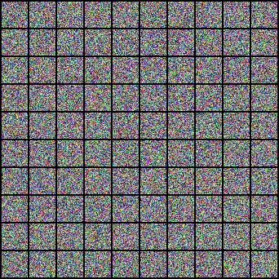
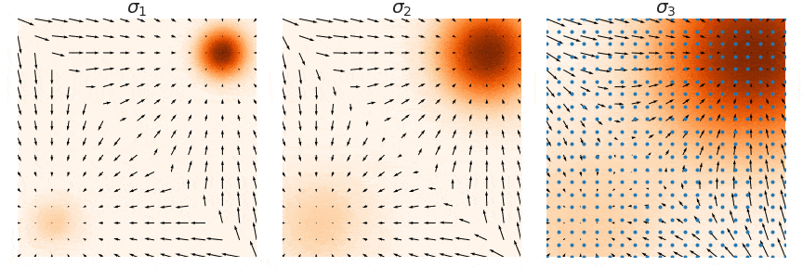
NCSN
https://slideslive.com/38957256/generative-modeling-by-estimating-gradients-of-the-data-distribution

Slide 43
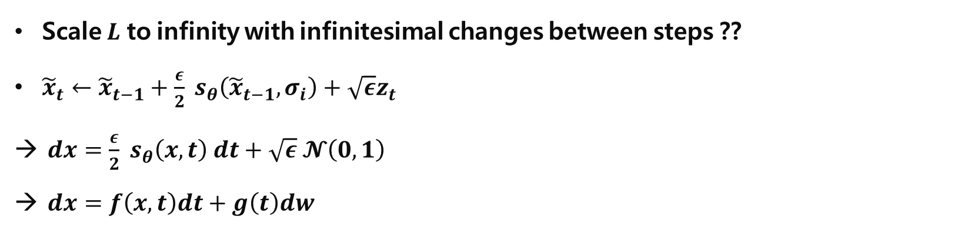
Score-Based Generative Modeling through Stochastic Differential Equations
Scale $L$ to infinity with infinitesimal changes between steps ??
${\tilde{x}}_{t}←{\tilde{x}}_{t−1}+\frac{ε}{2} s_{θ}\left({\tilde{x}}_{t−1}, σ_{i}\right)+\sqrt{ε}z_{t}$
$dx=\frac{ε}{2} s_{θ}\left(x, t\right) dt+\sqrt{ε} 𝓝\left(0, 1\right)$
$dx=f\left(x,t\right)dt+g\left(t\right)dw$
Song, Yang, and Stefano Ermon. "Generative modeling by estimating gradients of the data distribution." Advances in neural information processing systems 32 (2019).

Slide 44
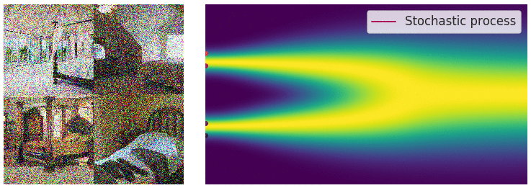
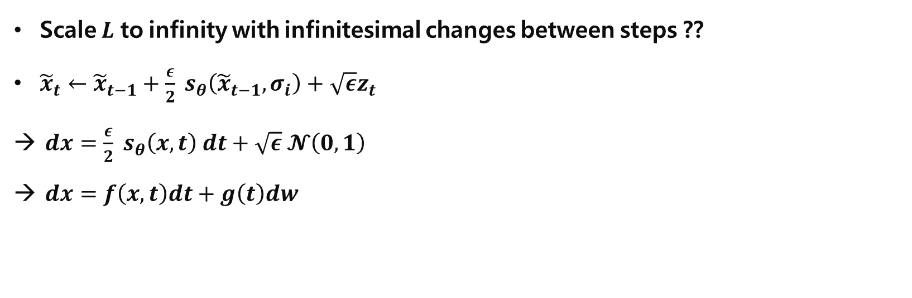
SDE
Scale $L$ to infinity with infinitesimal changes between steps ??
${\tilde{x}}_{t}←{\tilde{x}}_{t−1}+\frac{ε}{2} s_{θ}\left({\tilde{x}}_{t−1}, σ_{i}\right)+\sqrt{ε}z_{t}$
$dx=\frac{ε}{2} s_{θ}\left(x, t\right) dt+\sqrt{ε} 𝓝\left(0, 1\right)$
$dx=f\left(x,t\right)dt+g\left(t\right)dw$
Drift (deterministic; ODE)
Noise (stochastic)
Stochastic Differential Equation
High quality samples with infinitesimal noises
SDE solver, ODE approximation → Faster!
Tractable likelihood estimation..?
And…
Yang Song, [blog] Generative Modeling by Estimating Gradients of the Data Distribution https://yang-song.net/blog/2021/score/

Slide 45
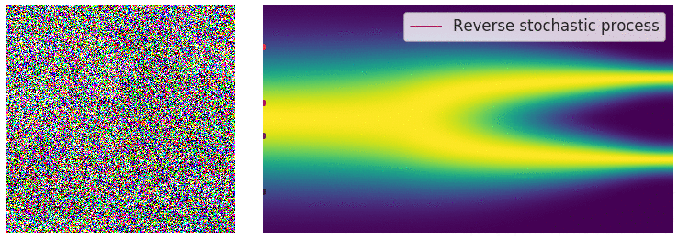
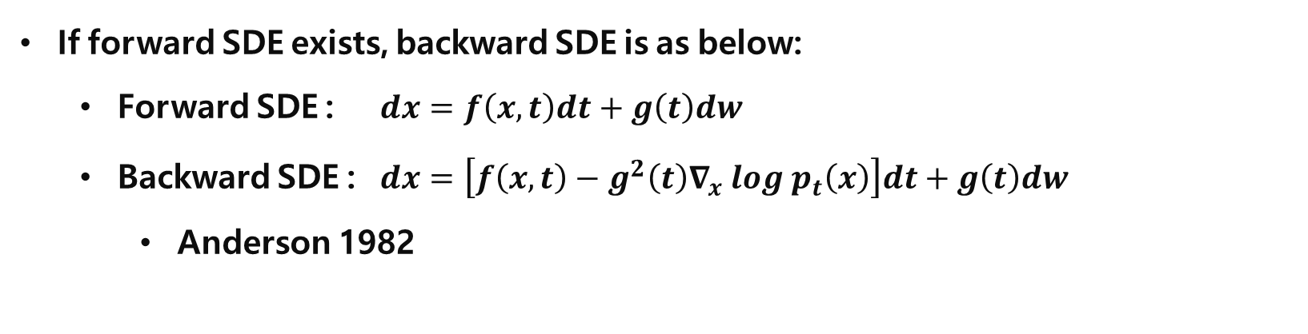
Forward SDE – Backward SDE
If forward SDE exists, backward SDE is as below:
Forward SDE : $dx=f\left(x,t\right)dt+g\left(t\right)dw$
Backward SDE : $dx=\left[f\left(x,t\right)−g^{2}\left(t\right)∇_{x} log p_{t}\left(x\right)\right]dt+g\left(t\right)dw$
Anderson 1982
Yang Song, [blog] Generative Modeling by Estimating Gradients of the Data Distribution https://yang-song.net/blog/2021/score/

Slide 46
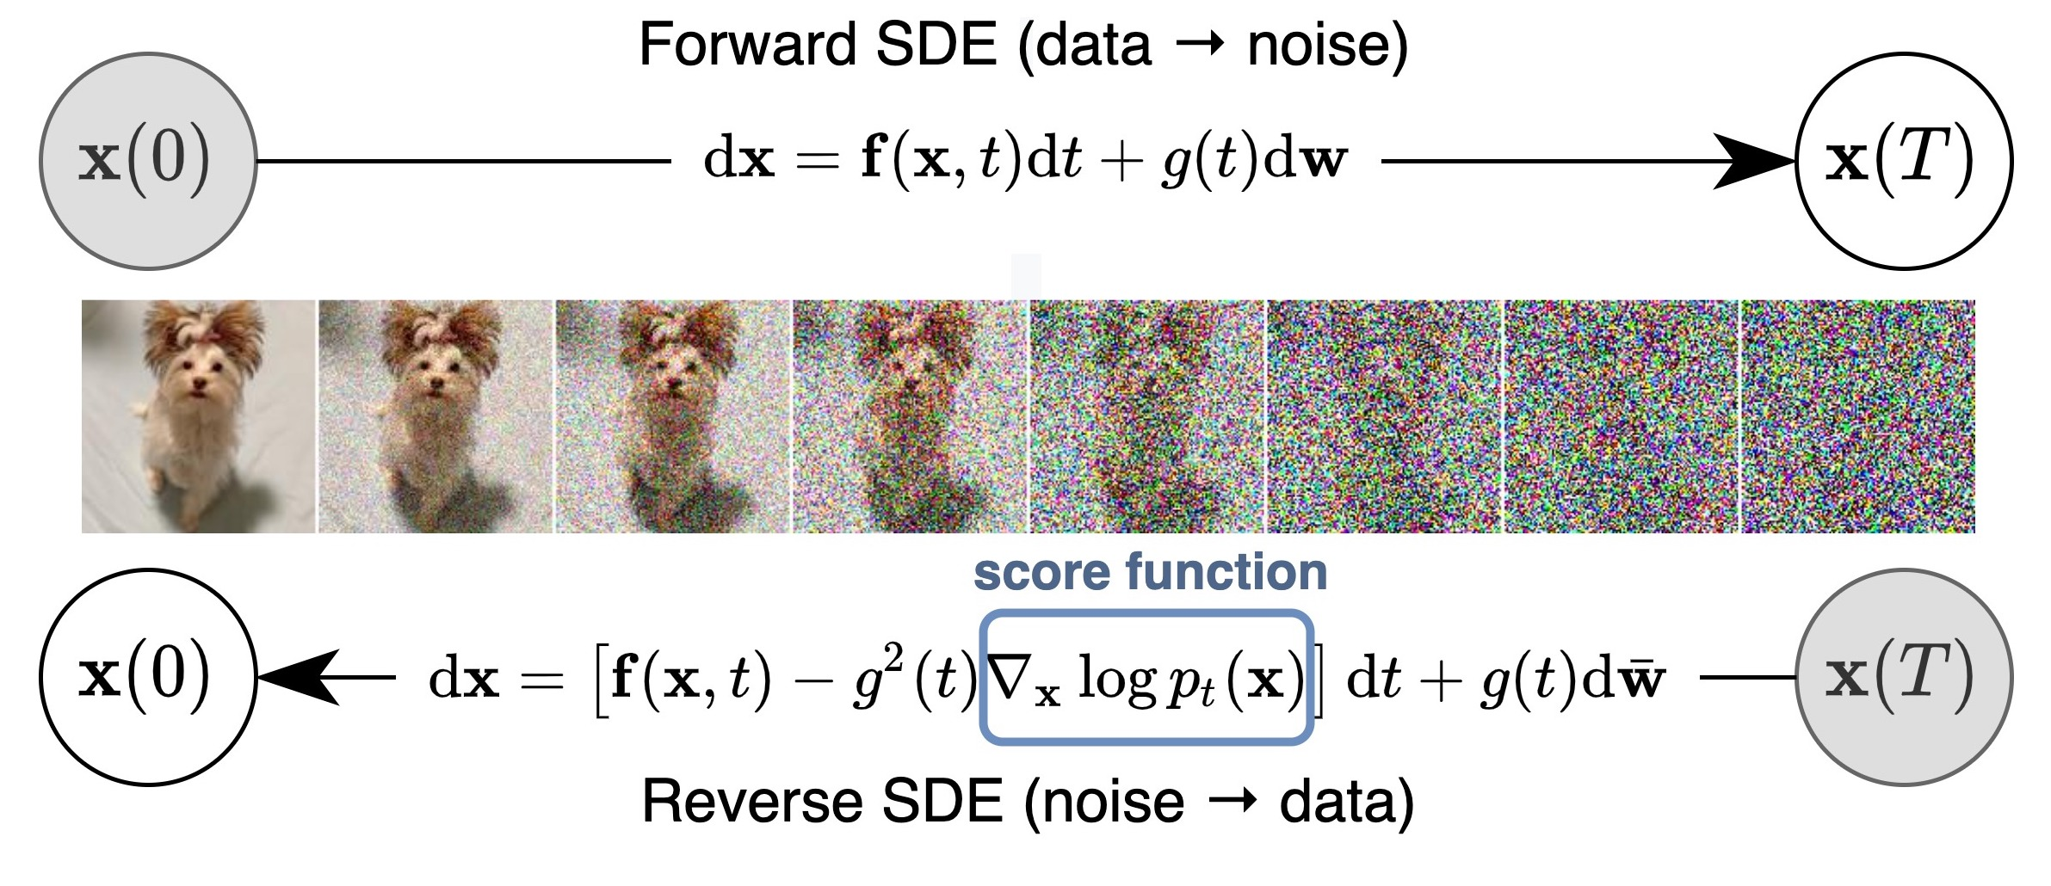
Forward SDE – Backward SDE
If forward SDE exists, backward SDE is as below:
Forward SDE : $dx=f\left(x,t\right)dt+g\left(t\right)dw$
Backward SDE : $dx=\left[f\left(x,t\right)−g^{2}\left(t\right)∇_{x} log p_{t}\left(x\right)\right]dt+g\left(t\right)dw$
Anderson 1982
Diffusion..?
Yang Song, [blog] Generative Modeling by Estimating Gradients of the Data Distribution https://yang-song.net/blog/2021/score/

Slide 47
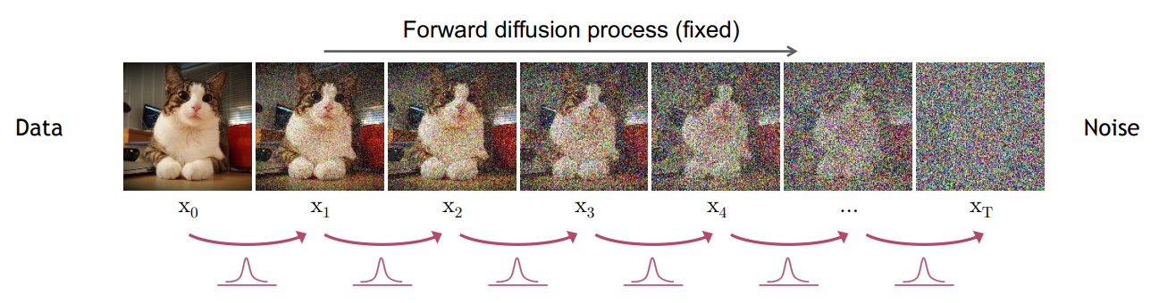
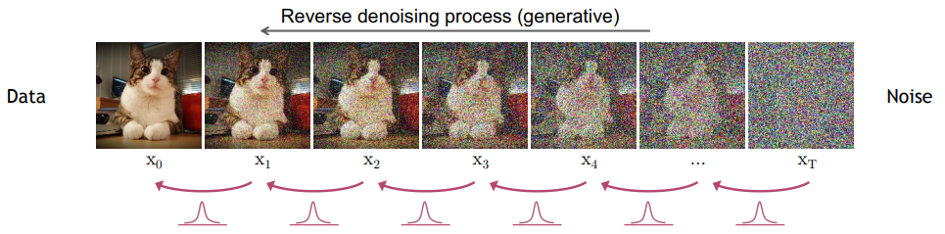
Forward SDE – Backward SDE
Diffusion..?
Yang Song, [blog] Generative Modeling by Estimating Gradients of the Data Distribution https://yang-song.net/blog/2021/score/

Slide 48


DDPM

Slide 49






DDPM
$$q(x_{t}|x_{t−1})$$
$$x_{0}$$
$$x_{T}$$
$β_{t}$ : Linear Scheduling
$$(10^{−4} \sim 0.02)$$
Standard Gaussian
$Var\left(aX\right)=a^{2}Var\left(X\right)$
$Var\left(X+Y\right)=Var\left(X\right)+Var\left(Y\right)$
$Var\left(\sqrt{1−β_{t}}x_{t−1}+β_{t}\right)$
$={\left(\sqrt{1−β_{t}}\right)}^{2}+β_{t}=1$
Markov Chain
Constant
$$q\left(x_{t−1} | x_{t}\right) ≈p_{θ}\left(x_{t−1}|x_{t}\right)$$

Slide 50


DDPM
Forward : $q\left(x_{t} | x_{t−1}\right)= 𝓝(x_{t}; \sqrt{1−β_{t}}x_{t−1}, β_{t}I)$, $β_{t} : Linear Scheduling$
$q\left(x_{t} | x_{0}\right)= 𝓝\left(x_{t};\sqrt{α_{t}}x_{0}, \left(1−α_{t}\right)I\right), α_{t}=1−β_{t},α_{t}= \prod_{s=1}^{t}{\overline{α_{s}}}$
Sample $ε \sim 𝓝\left(0, 1\right), x_{t}=\sqrt{α_{t}}x_{0}+\sqrt{1 −α_{t}}ε$
Backward : $q\left(x_{t−1} | x_{t}\right) ≈p_{θ}\left(x_{t−1}|x_{t}\right)=𝓝(x_{t−1}; μ_{θ}\left(x_{t}, t\right), σ_{t}^{2}I)$
$σ_{t}^{2}∙I=\tilde{β_{t}}=\frac{1−α_{t−1}}{1−α_{t}}β_{t}, α_{t}≔ \prod_{s=1}^{t}{\overline{α_{s}}}, \overline{α_{t}}=1−β_{t}$

Slide 51


DDPM - Loss
$=E_{x_{0}, ε}\left[\frac{β_{t}^{2}}{2σ_{t}^{2}\overline{α_{t}}(1−α_{t})} {\left|ε −ε_{θ}\left(\sqrt{α_{t}}x_{0}+\sqrt{1−α_{t}}ε, t\right)\right|}^{2}\right]$
$=L_{simple}= E_{x_{0}, ε}\left[ {\left|ε −ε_{θ}\left(\sqrt{α_{t}}x_{0}+\sqrt{1−α_{t}}ε, t\right)\right|}^{2}\right]$

Slide 52
DDPM
https://cvpr2022-tutorial-diffusion-models.github.io/

Slide 53

DDPM
$x_{t}=\sqrt{1−β_{t}}x_{t−1}+\sqrt{β_{t}}𝓝\left(0,1\right)$
$=\sqrt{1−β\left(t\right)Δt}x_{t−1}+\sqrt{β\left(t\right)Δt}𝓝\left(0,1\right) (β_{t} ≔β\left(t\right)Δt)$
$≈x_{t−1} −\frac{β\left(t\right)Δt}{2}x_{t−1}+\sqrt{β\left(t\right)Δt}𝓝\left(0,1\right) \left(Taylor Expansion\right)$
$≈dx_{t}=−\frac{1}{2}β\left(t\right)x_{t}dt+\sqrt{β\left(t\right)}dw_{t} →dx_{t}=f\left(t\right)x_{t}dt+g\left(t\right)dw_{t}$ → SDE
https://cvpr2022-tutorial-diffusion-models.github.io/

Slide 54






Denoising Score Matching
How can we define Loss?
→ $\begin{aligned}min \\ θ\end{aligned} 𝔼_{t\sim u(0,T)}𝔼_{x_{t}\sim q_{t}(x_{t})}∥s_{θ}\left(x_{t}, t\right)−∇_{x_{t}}log q_{t}\left(x_{t}\right)∥_{2}^{2}$
→ $\begin{aligned}min \\ θ\end{aligned} 𝔼_{t\sim u(0,T)} 𝔼_{x_{0}\sim q_{0}(x_{0})} 𝔼_{x_{t}\sim q_{t}(x_{t}|x_{0})}∥s_{θ}\left(x_{t}, t\right)−∇_{x_{t}}log q_{t}\left(x_{t}|x_{0}\right)∥_{2}^{2}$
→ Reparametrized sampling : $x_{t}=γ_{t}x_{0}+σ_{t}ε ε \sim 𝓝\left(0,1\right)$
→ Score function : $∇_{x_{t}}log q_{t}\left(x_{t} | x_{0}\right)=−∇x_{t}\frac{{\left(x_{t}−γ_{t}x_{0}\right)}^{2}}{2σ_{t}^{2}}=−\frac{x_{t}−γ_{t}x_{0}}{σ_{t}^{2}}=−\frac{γ_{t}x_{0}+σ_{t}ε −γ_{t}x_{0}}{σ_{t}^{2}}=−\frac{ε}{σ_{t}}$
→ Neural network model : $s_{θ}\left(x_{t}, t\right)≔−\frac{ε_{θ}(x_{t}, t)}{σ_{t}}$
→ Loss : $\begin{aligned}min \\ θ\end{aligned} 𝔼_{t\sim u(0,T)} 𝔼_{x_{0}\sim q_{0}(x_{0})} 𝔼_{ε\sim 𝓝(0,I)}\frac{1}{σ_{t}^{2}}∥ε−ε_{θ} \left(x_{t}, t\right)∥_{2}^{2}$
Not tractable
$$q\left(x_{t} | x_{0}\right)= 𝓝\left(x_{t};\sqrt{α_{t}}x_{0}, \left(1−α_{t}\right)I\right), α_{t}=1−β_{t},α_{t}= \prod_{s=1}^{t}{\overline{α_{s}}}$$
$$Variance preserving SDE :$$
$$dx_{t}=−\frac{1}{2}β\left(t\right)x_{t}dt+\sqrt{β\left(t\right)}dw_{t}$$
$$q_{t}\left(x_{t} | x_{0}\right)=𝓝\left(x_{t};γ_{t}x_{0}, σ_{t}^{2}I\right)$$
$$γ_{t}=e^{−\frac{1}{2}\int_{0}^{t}{β\left(s\right)ds}}$$
$$σ_{t}^{2}=1−e^{−\int_{0}^{t}{β\left(s\right)ds}}$$
Diffusion time $t$
Data sample $x_{0}$
Diffused data sample $x_{t}$
Score of diffused data sample

Slide 55

DDPM - SDE
$dx_{t}=−\frac{1}{2}β\left(t\right)x_{t}dt+\sqrt{β\left(t\right)}dw_{t} →dx_{t}=f\left(t\right)x_{t}dt+g\left(t\right)dw_{t}$ → SDE
Loss : $\begin{aligned}min \\ θ\end{aligned} 𝔼_{t\sim u(0,T)} 𝔼_{x_{0}\sim q_{0}(x_{0})} 𝔼_{ε\sim 𝓝(0,I)}\frac{1}{σ_{t}^{2}}∥ε−ε_{θ} \left(x_{t}, t\right)∥_{2}^{2}$
Sampling
Forward SDE : $dx=f\left(x,t\right)dt+g\left(t\right)dw$
Backward SDE : $dx=\left[f\left(x,t\right)−g^{2}\left(t\right)∇_{x} log p_{t}\left(x\right)\right]dt+g\left(t\right)dw$

Slide 56


DDPM - SDE
$dx_{t}=−\frac{1}{2}β\left(t\right)x_{t}dt+\sqrt{β\left(t\right)}dw_{t} →dx_{t}=f\left(t\right)x_{t}dt+g\left(t\right)dw_{t}$ → SDE
Loss : $\begin{aligned}min \\ θ\end{aligned} 𝔼_{t\sim u(0,T)} 𝔼_{x_{0}\sim q_{0}(x_{0})} 𝔼_{ε\sim 𝓝(0,I)}\frac{1}{σ_{t}^{2}}∥ε−ε_{θ} \left(x_{t}, t\right)∥_{2}^{2}$
Sampling
Forward SDE : $dx=f\left(x,t\right)dt+g\left(t\right)dw$
Backward SDE :
Numerical Method

Slide 57


Predictor – Corrector Sampling
Predictor : SDE Solver
Corrector : Langevin Dynamics $dx=\left[f\left(x,t\right)−g^{2}\left(t\right)s_{θ}(x)\right]dt+g\left(t\right)dw$
https://cvpr2022-tutorial-diffusion-models.github.io/

Slide 58


Comparison
DDPM
Diffusion process (Markovian)
Slightly adding noise
Sampling (Markovian)
Slightly denoising
Loss with MSE
Standard Gaussian <-> $ε_{θ}$
Discrete steps
Score-based through SDE
Data distribution
Large noise to small noise
Score function
Sampling (Annealed Langevin)
Slightly denoising
Loss with MSE
$∇_{x}log p_{data}\left(x\right)$ <-> $s_{θ}\left(x\right)$
Continuous → Solver

Slide 59
Comparison
DDPM
Diffusion process (Markovian)
Slightly adding noise
Sampling (Markovian)
Slightly denoising
Loss with MSE
Standard Gaussian <-> $ε_{θ}$
Discrete steps
Score-based through SDE
Data distribution
Large noise to small noise
Score function
Sampling (Annealed Langevin)
Slightly denoising
Loss with MSE
$∇_{x}log p_{data}\left(x\right)$ <-> $s_{θ}\left(x\right)$
Continuous → Solver
Same!

Slide 60

Tractable Likelihood Estimation?
Deterministic
Song, Yang, and Stefano Ermon. "Generative modeling by estimating gradients of the data distribution." Advances in neural information processing systems 32 (2019).

Slide 61
Tractable Likelihood Estimation?
Deterministic …. DDIM?
Song, Yang, and Stefano Ermon. "Generative modeling by estimating gradients of the data distribution." Advances in neural information processing systems 32 (2019).

Slide 62

DDIM – Generation
Generating sample $x_{t−1}$ from $x_{t}$
$x_{t−1}=\sqrt{α_{t−1}}\left(\frac{x_{t}−\sqrt{1−α_{t}}ε_{θ}^{\left(t\right)}(x_{t})}{\sqrt{α_{t}}}\right)+\sqrt{1−α_{t−1}−σ_{t}^{2}}∙ε_{θ}^{\left(t\right)}\left(x_{t}\right)+σ_{t}ε_{t}$
Predicted $x_{0}$ direction pointing to $x_{t}$ random noise
If $σ_{t}=0 for all t$
deterministic generative process with randomness from only t=T
Fast sampling

Slide 63

DDIM – Score-based through SDE
$x_{t−1}=\sqrt{α_{t−1}}\left(\frac{x_{t}−\sqrt{1−α_{t}}ε_{θ}^{\left(t\right)}(x_{t})}{\sqrt{α_{t}}}\right)+\sqrt{1−α_{t−1}−σ_{t}^{2}}∙ε_{θ}^{\left(t\right)}\left(x_{t}\right)+σ_{t}ε_{t}$
$dx=\left[f\left(x,t\right)−g^{2}\left(t\right)∇_{x} log p_{t}\left(x\right)\right]dt+g\left(t\right)dw$ (SDE)
Eliminate noise term
Noise term

Slide 64

DDIM – Score-based through SDE
$x_{t−1}=\sqrt{α_{t−1}}\left(\frac{x_{t}−\sqrt{1−α_{t}}ε_{θ}^{\left(t\right)}(x_{t})}{\sqrt{α_{t}}}\right)+\sqrt{1−α_{t−1}−σ_{t}^{2}}∙ε_{θ}^{\left(t\right)}\left(x_{t}\right)+σ_{t}ε_{t}$
$dx=\left[f\left(x,t\right)−g^{2}\left(t\right)∇_{x} log p_{t}\left(x\right)\right]dt+g\left(t\right)dw$ (SDE)
Noise term

Slide 65

DDIM – Score-based through SDE
$x_{t−1}=\sqrt{α_{t−1}}\left(\frac{x_{t}−\sqrt{1−α_{t}}ε_{θ}^{\left(t\right)}(x_{t})}{\sqrt{α_{t}}}\right)+\sqrt{1−α_{t−1}−σ_{t}^{2}}∙ε_{θ}^{\left(t\right)}\left(x_{t}\right)$ → Deterministic
$dx=\left[f\left(x,t\right)−g^{2}\left(t\right)∇_{x} log p_{t}\left(x\right)\right]dt$→ Deterministic
→ Probability Flow ODE

Slide 66

DDIM – Score-based through SDE
$x_{t−1}=\sqrt{α_{t−1}}\left(\frac{x_{t}−\sqrt{1−α_{t}}ε_{θ}^{\left(t\right)}(x_{t})}{\sqrt{α_{t}}}\right)+\sqrt{1−α_{t−1}−σ_{t}^{2}}∙ε_{θ}^{\left(t\right)}\left(x_{t}\right)$ → Deterministic
$dx=\left[f\left(x,t\right)−g^{2}\left(t\right)∇_{x} log p_{t}\left(x\right)\right]dt$→ Deterministic
→ Probability Flow ODE
https://cvpr2022-tutorial-diffusion-models.github.io/

Slide 67

DDIM – Score-based through SDE
$x_{t−1}=\sqrt{α_{t−1}}\left(\frac{x_{t}−\sqrt{1−α_{t}}ε_{θ}^{\left(t\right)}(x_{t})}{\sqrt{α_{t}}}\right)+\sqrt{1−α_{t−1}−σ_{t}^{2}}∙ε_{θ}^{\left(t\right)}\left(x_{t}\right)$ → Deterministic
$dx=\left[f\left(x,t\right)−g^{2}\left(t\right)∇_{x} log p_{t}\left(x\right)\right]dt$→ Deterministic
→ Probability Flow ODE
https://cvpr2022-tutorial-diffusion-models.github.io/

Slide 68
Probability Flow ODE
https://cvpr2022-tutorial-diffusion-models.github.io/

Slide 69



Neural ODE
$dx=\left[f\left(x,t\right)−\frac{1}{2}g^{2}\left(t\right)s_{θ}\left(x,t\right)\right]dt$ → Neural ODE (as in DDIM)
Exact likelihood computation via instantaneous change-of-variable
$$log p_{T}\left(z\right) → \int{}→log p_{0}(x)$$
PR-400: Score-based Generative Modeling Through Stochastic Differential Equations https://youtu.be/uG2ceFnUeQU

Slide 70

Uniquely Identifiable Encoding
PR-400: Score-based Generative Modeling Through Stochastic Differential Equations https://youtu.be/uG2ceFnUeQU

Slide 71

Conditional Generation
Apply conditional probability $y$
$dx=\left[f\left(x,t\right)−g^{2}\left(t\right)∇_{x} log p_{t}\left(x\right)\right]dt+g\left(t\right)dw$

Slide 72

Conditional Generation
Apply conditional probability $y$
$dx=\left[f\left(x,t\right)−g^{2}\left(t\right)∇_{x} log p_{t}\left(x | y\right)\right]dt+g\left(t\right)dw$

Slide 73

Conditional Generation
Apply conditional probability $y$
$dx=\left[f\left(x,t\right)−g^{2}\left(t\right)∇_{x} log p_{t}\left(x | y\right)\right]dt+g\left(t\right)dw$
$dx=\left[f\left(x,t\right)−g^{2}\left(t\right)∇_{x} log p_{t}\left(x\right)−g^{2}\left(t\right)∇_{x} log p_{t}\left(y | x\right)\right]dt+g\left(t\right)dw$

Slide 74
Conditional Generation
Apply conditional probability $y$
$dx=\left[f\left(x,t\right)−g^{2}\left(t\right)∇_{x} log p_{t}\left(x | y\right)\right]dt+g\left(t\right)dw$
$dx=\left[f\left(x,t\right)−g^{2}\left(t\right)∇_{x} log p_{t}\left(x\right)−g^{2}\left(t\right)∇_{x} log p_{t}\left(y | x\right)\right]dt+g\left(t\right)dw$
Unconditional score function
Not related with Score function
→ Classifier

Slide 75

Conclusion
Faster, better generation
Exact likelihood computation
Uniquely identifiable encoding
Controllable generation
Class-conditional generation, inpaining…
Just add classifier to pretrained models

Slide 76


Classifier Guidance
For class-conditional modeling of $p\left(x_{t} \right| c)$, train an extra classifier $p\left(c \right| x_{t})$
Mix its gradient with the diffusion / score model during sampling
Dhariwal, Prafulla, and Alexander Nichol. "Diffusion models beat gans on image synthesis." Advances in Neural Information Processing Systems 34 (2021): 8780-8794.

Slide 77

Result
For class-conditional modeling of $p\left(x_{t} \right| c)$, train an extra classifier $p\left(c \right| x_{t})$
Mix its gradient with the diffusion / score model during sampling
Dhariwal, Prafulla, and Alexander Nichol. "Diffusion models beat gans on image synthesis." Advances in Neural Information Processing Systems 34 (2021): 8780-8794.

Slide 78

Conditional Diffusion generation
https://cvpr2022-tutorial-diffusion-models.github.io/

Slide 79

Conditional Diffusion generation
https://cvpr2022-tutorial-diffusion-models.github.io/

Slide 80

Conditional Diffusion generation
https://cvpr2022-tutorial-diffusion-models.github.io/

Slide 81
Thank
You
감사합니다.

